Slide 1

Roughness in SLS Eos P500 FDR
Chances in:
build plate position
Build setup
Presence of thin walls

Slide 2
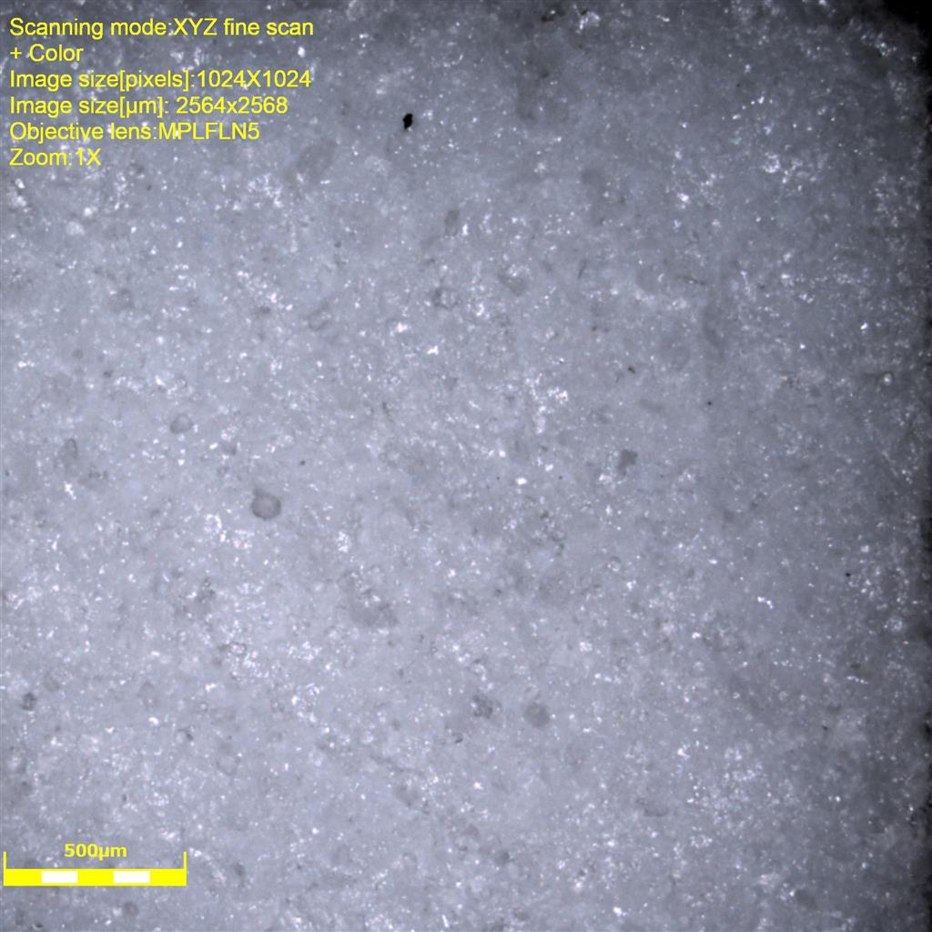
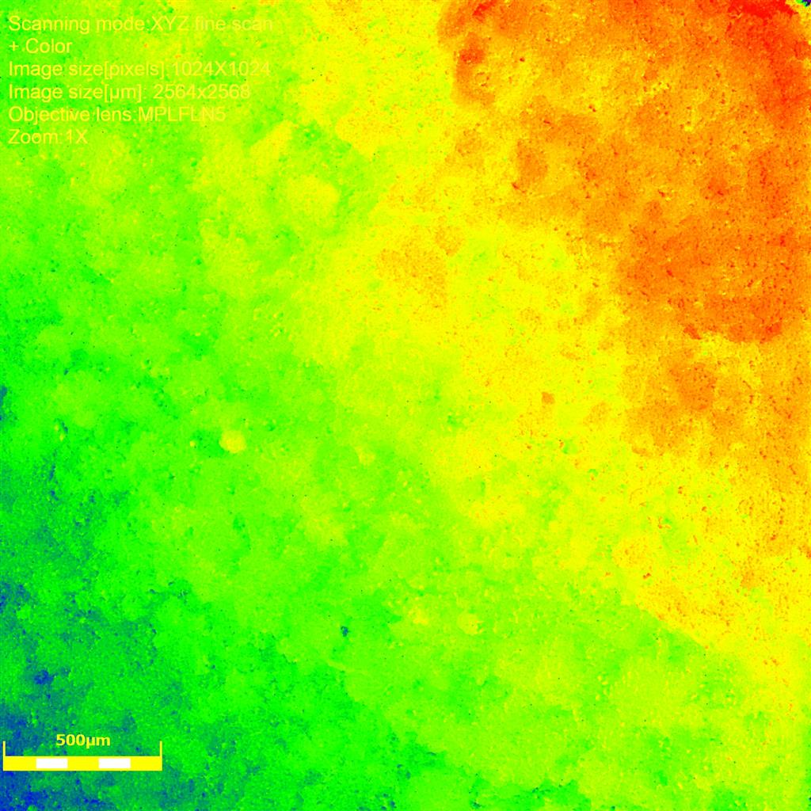
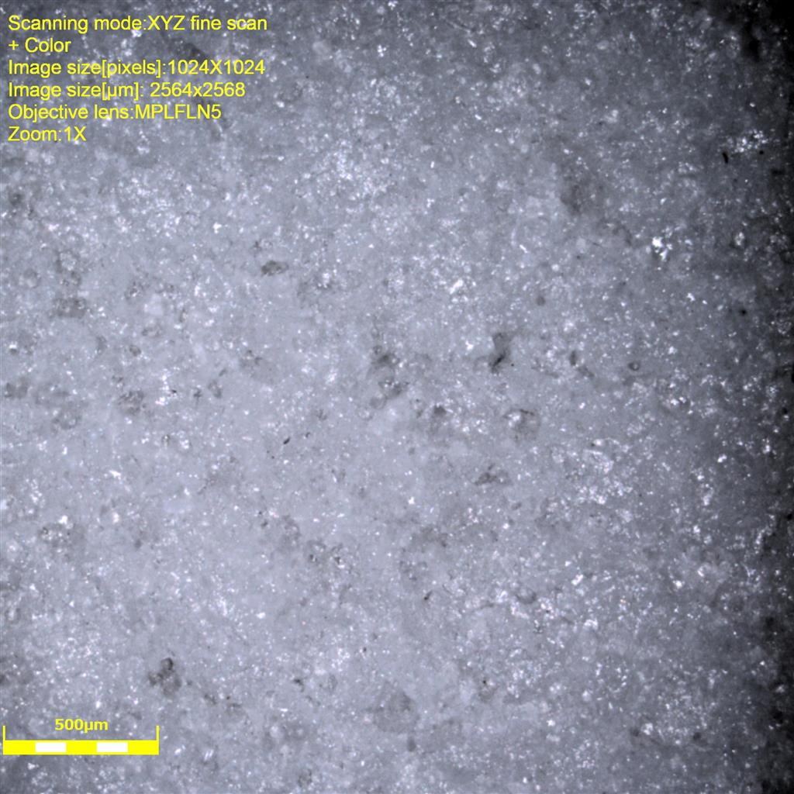
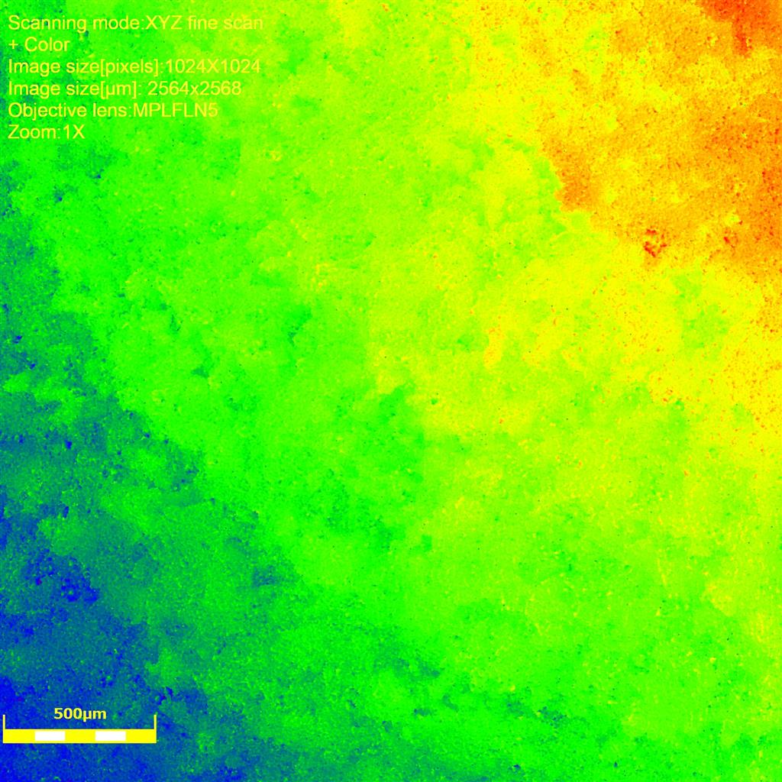
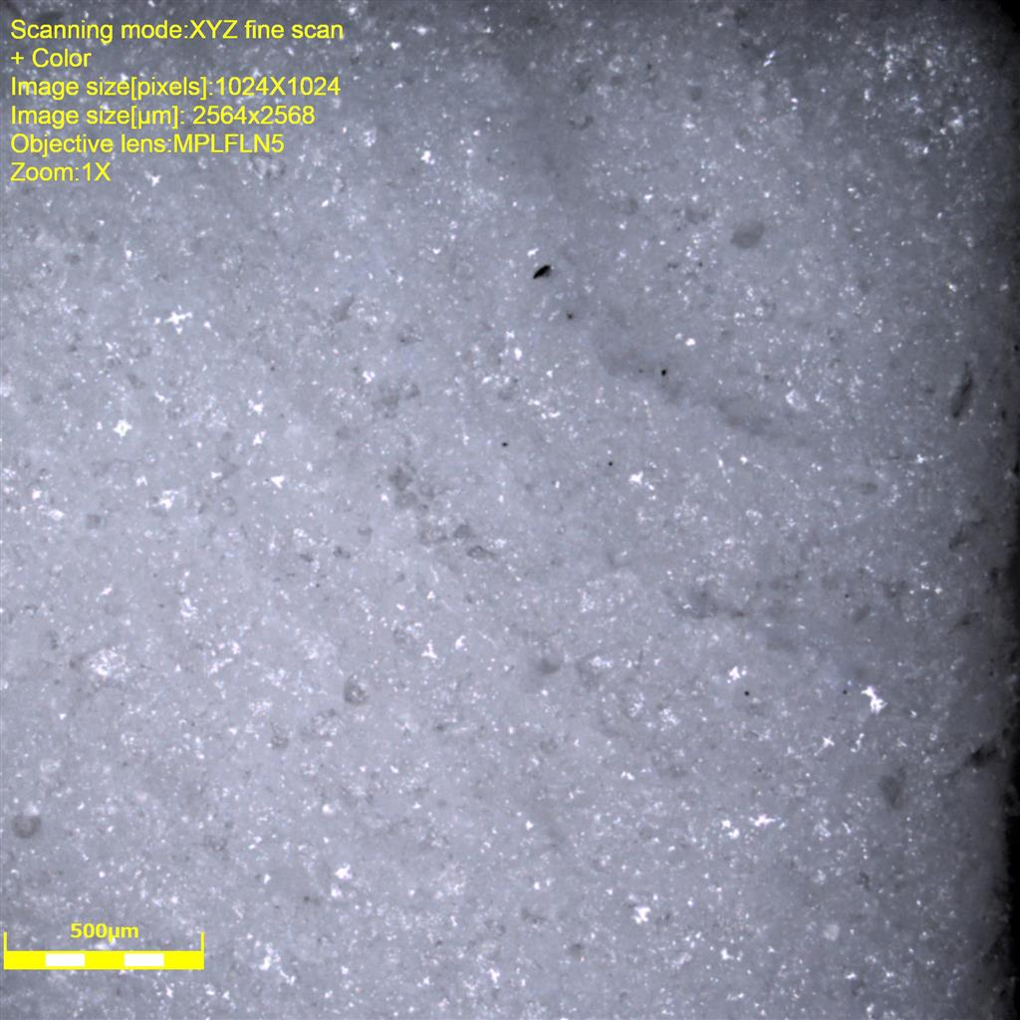
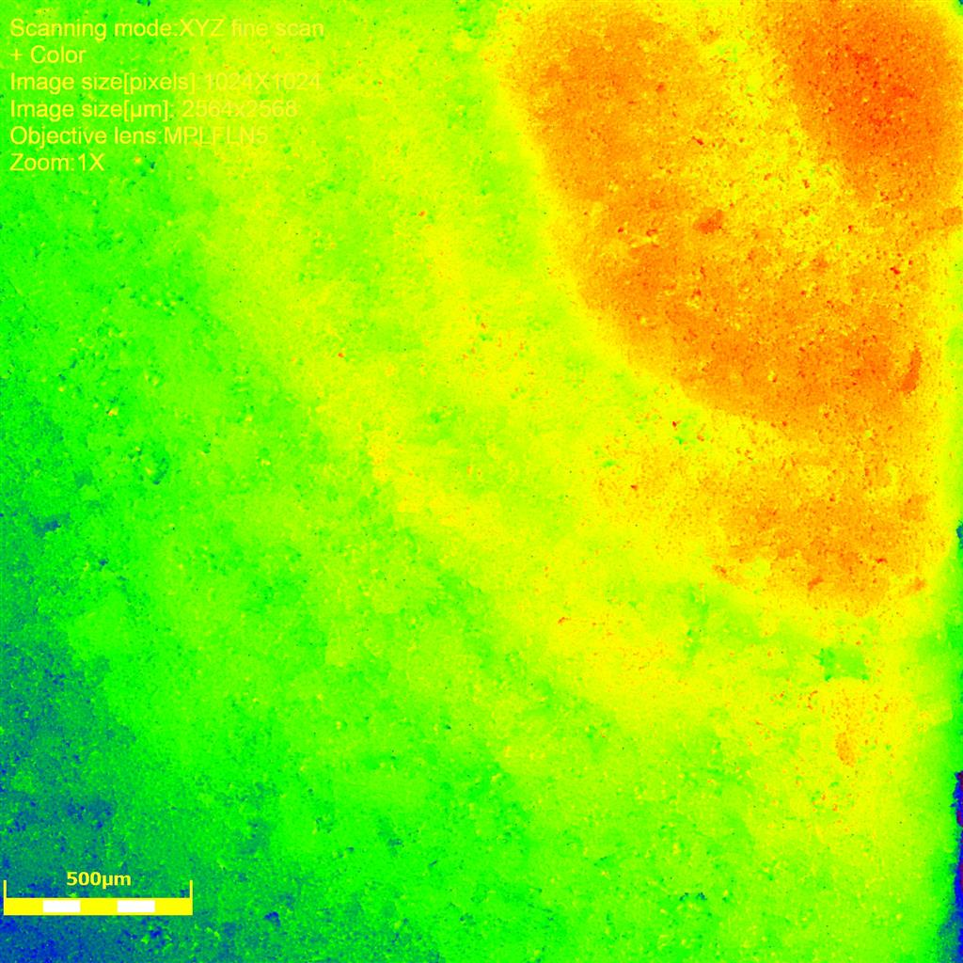
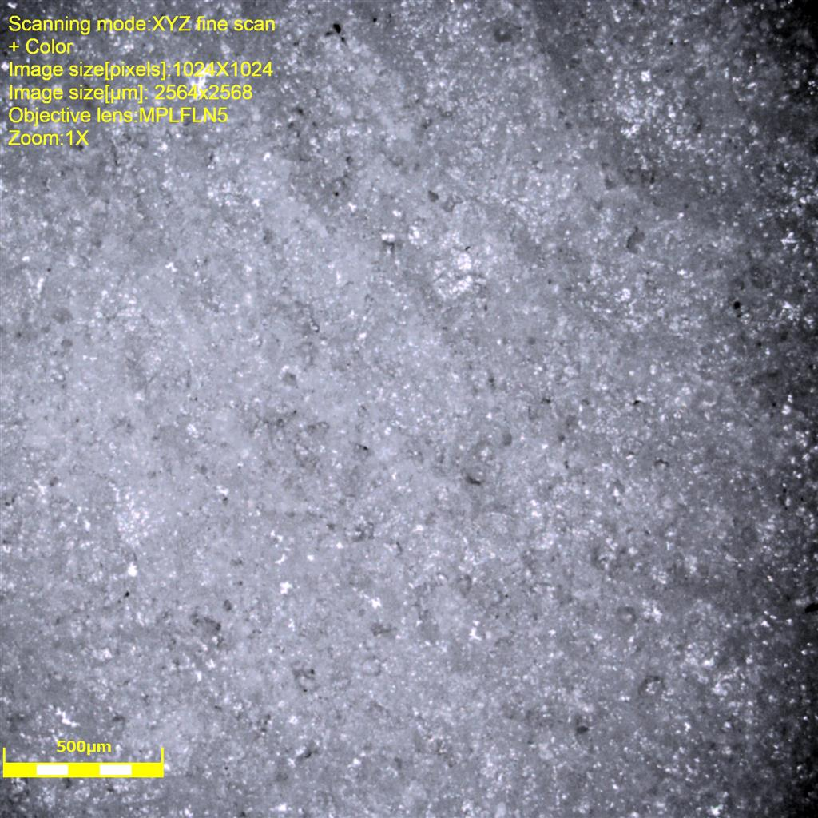
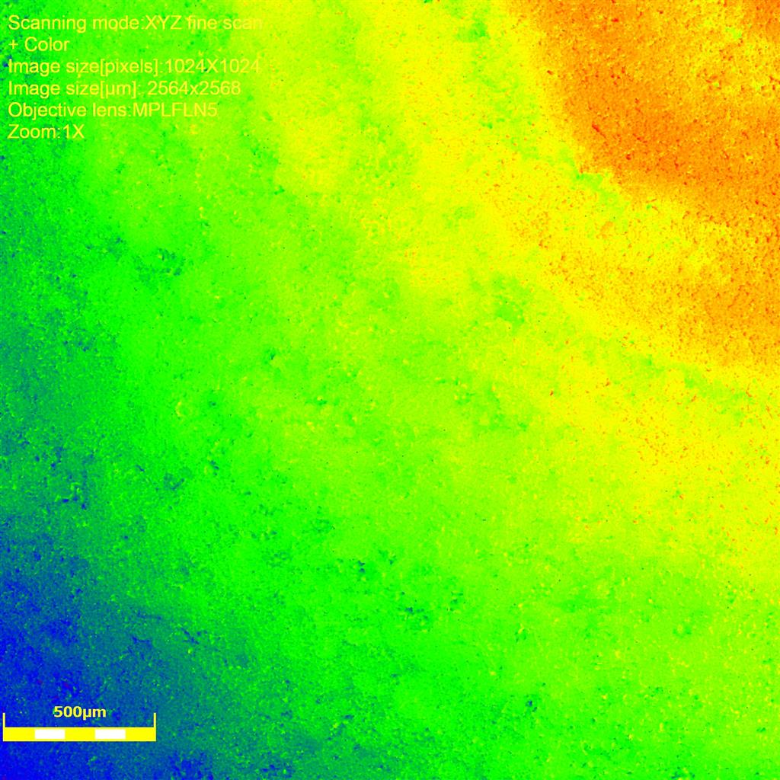
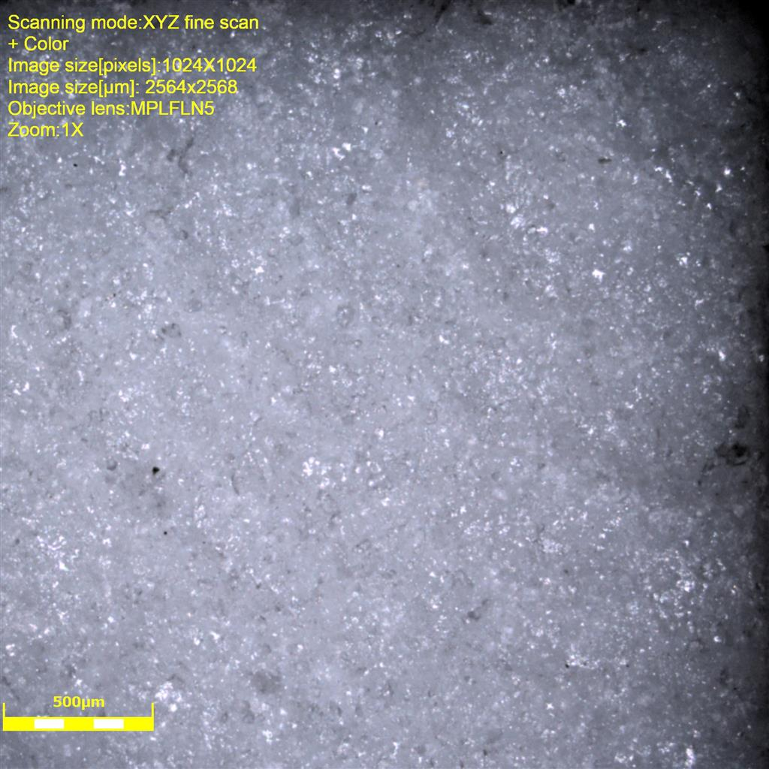
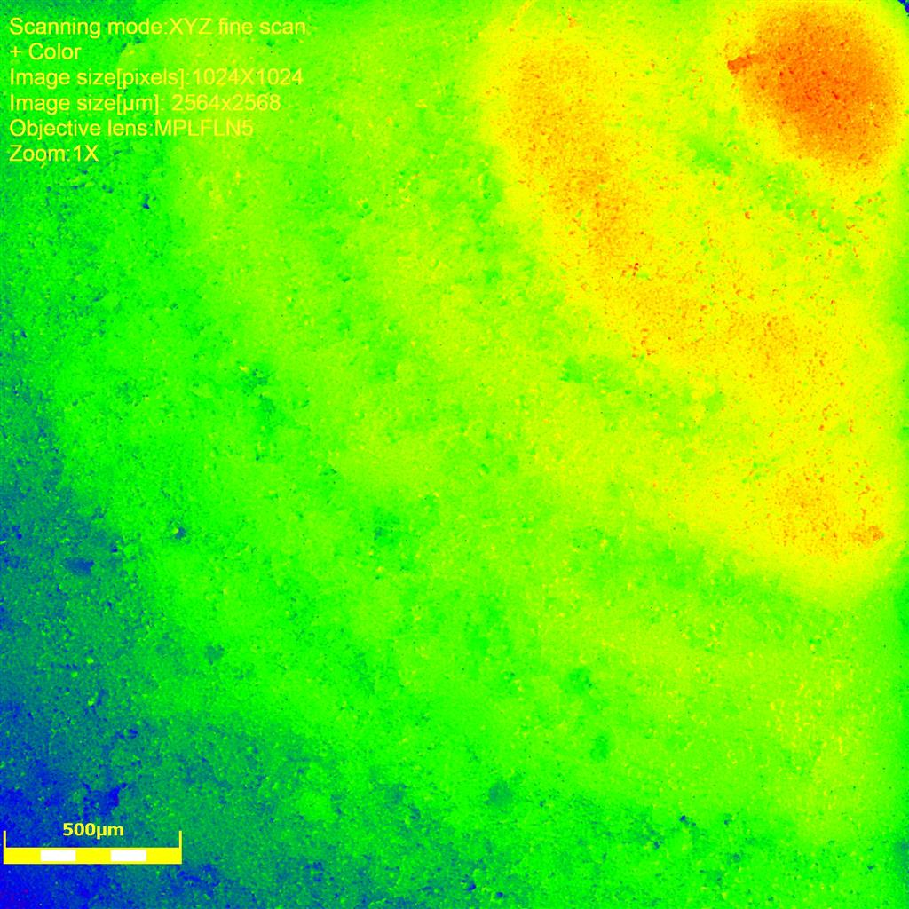
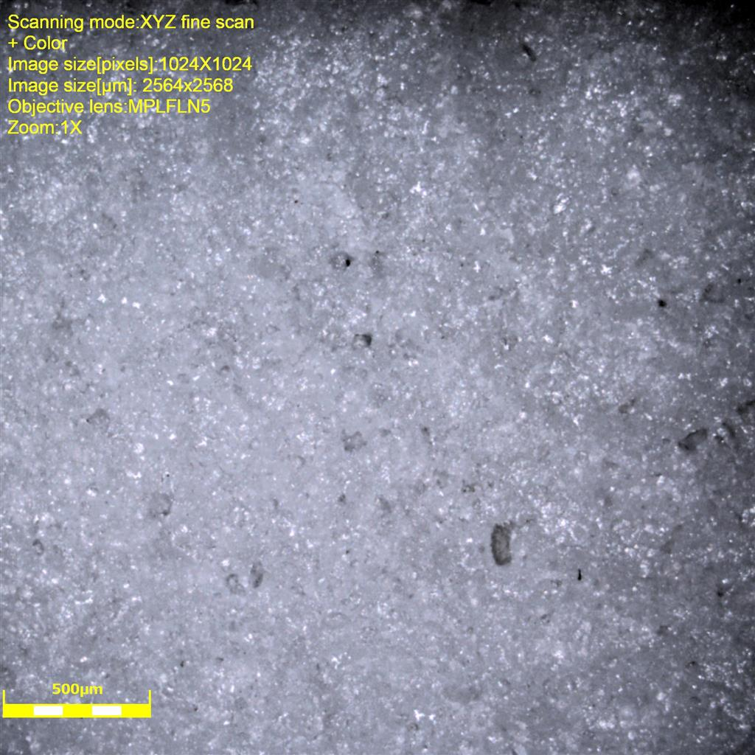
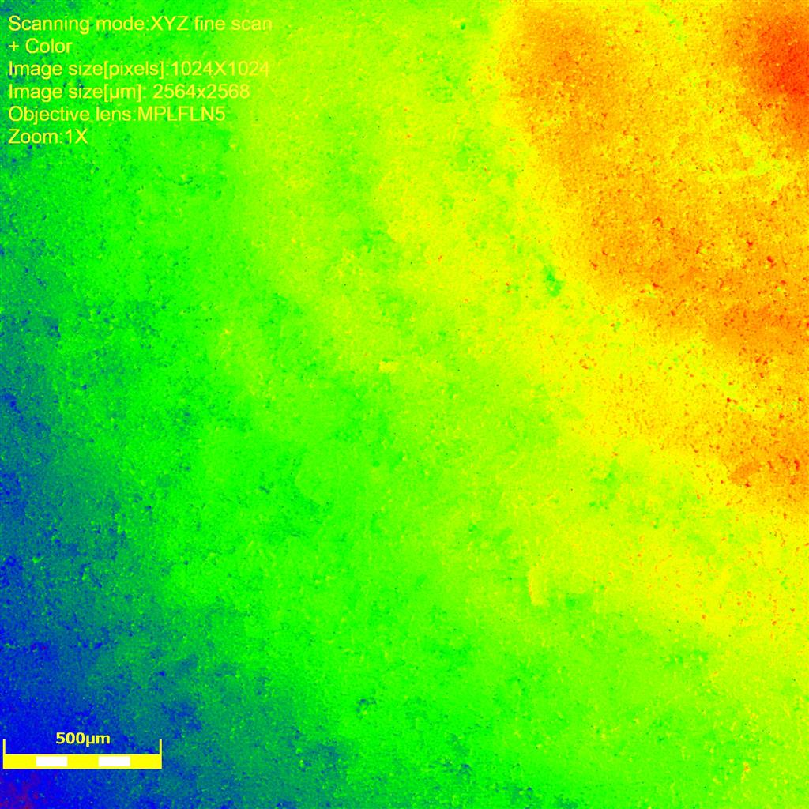
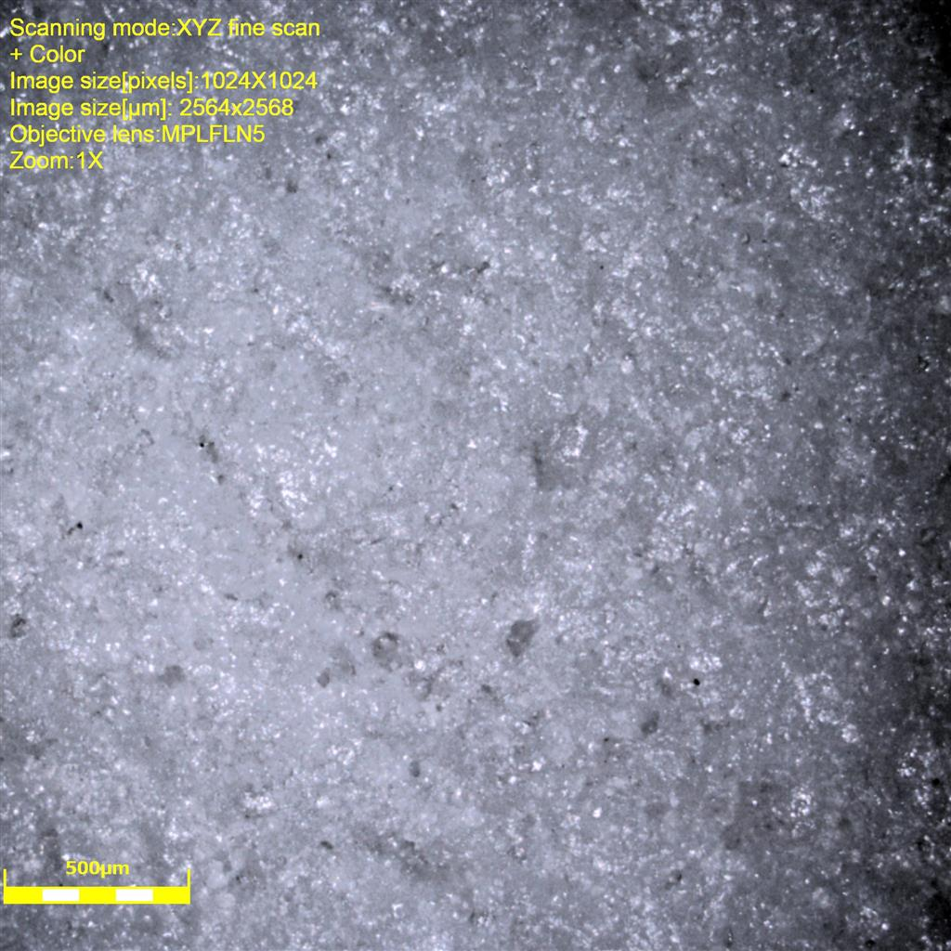
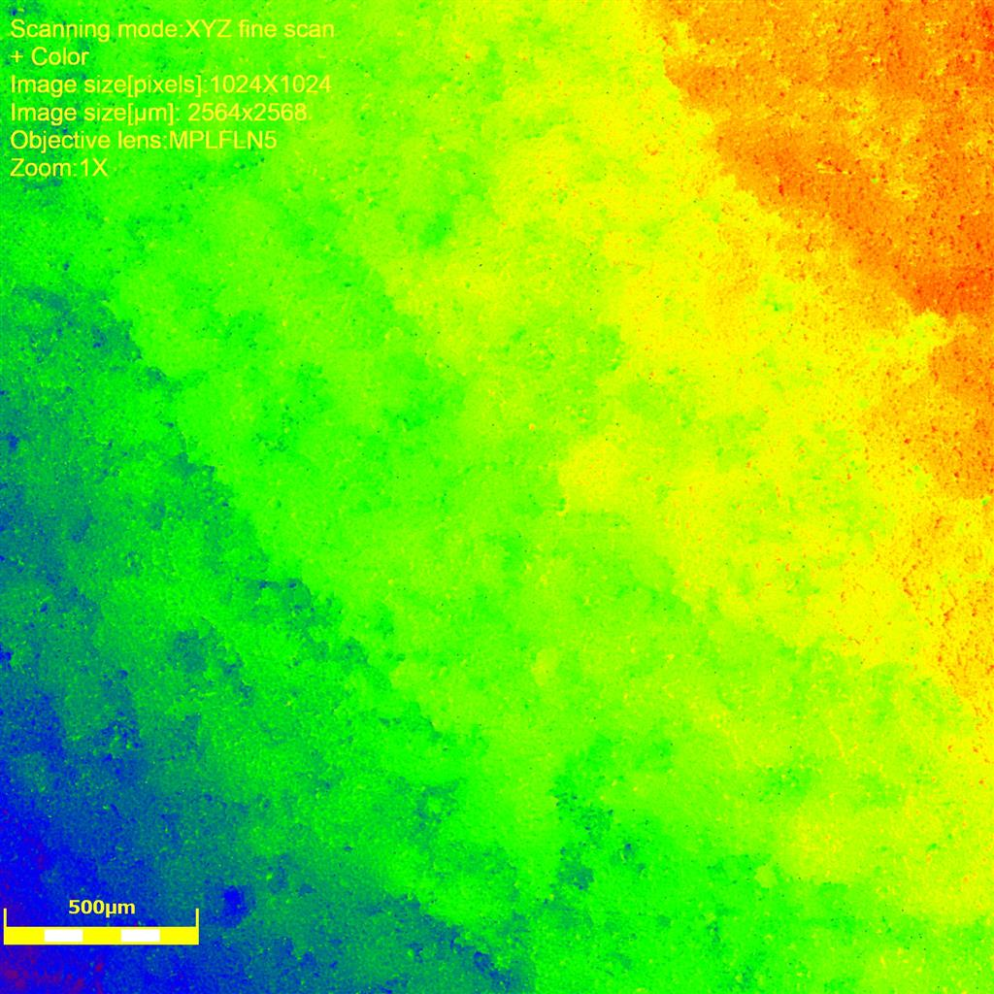
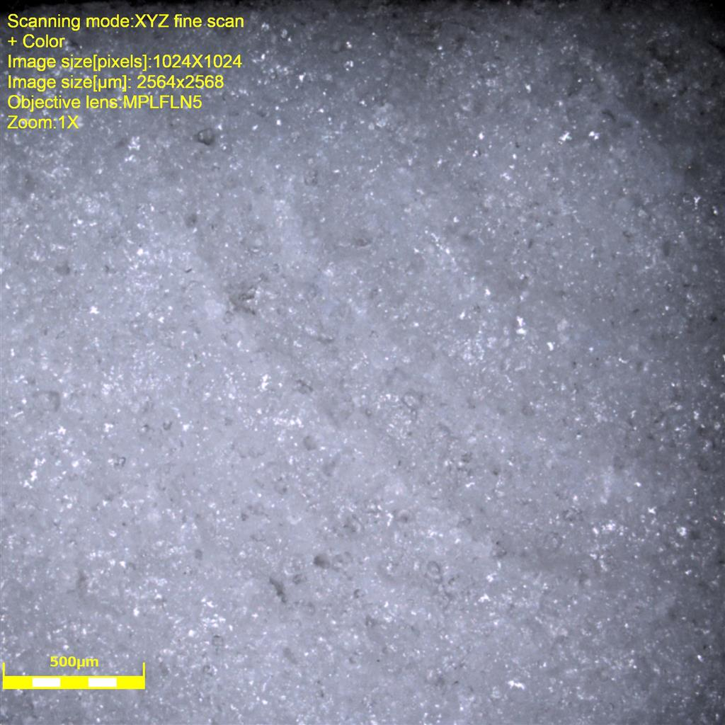
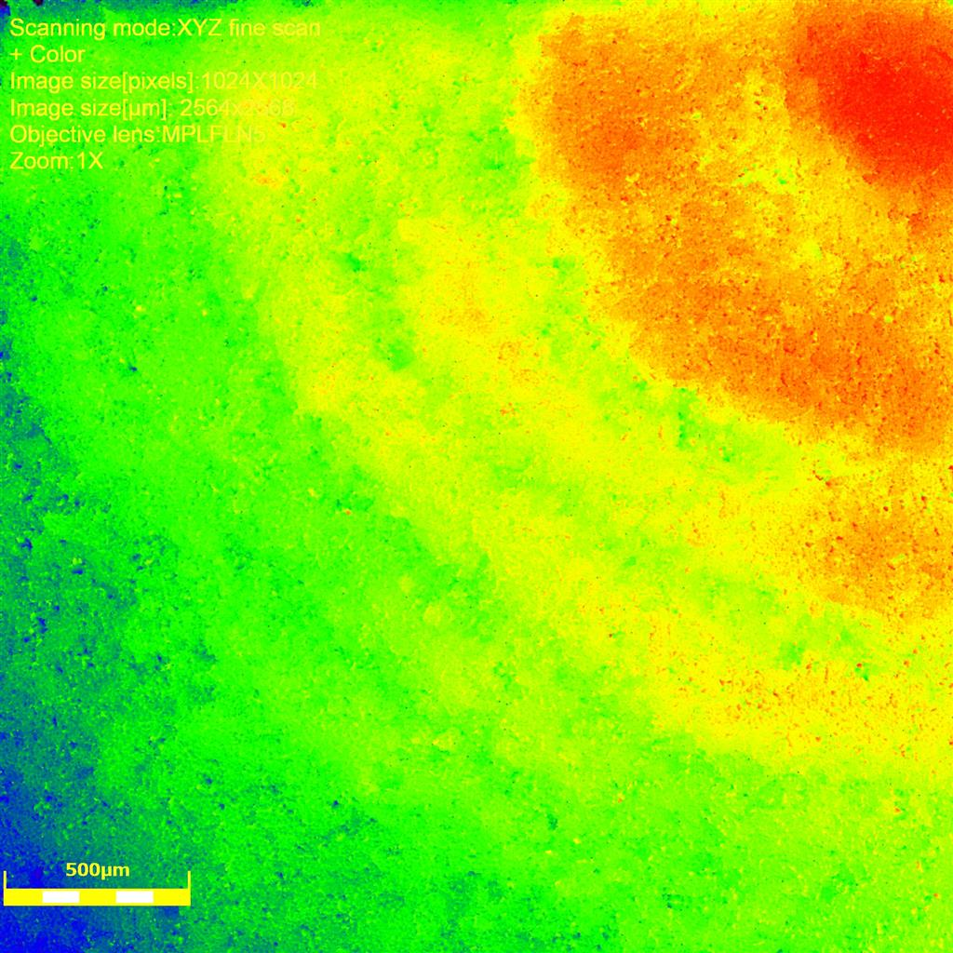
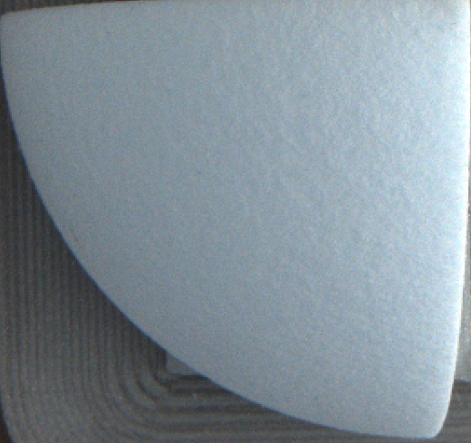
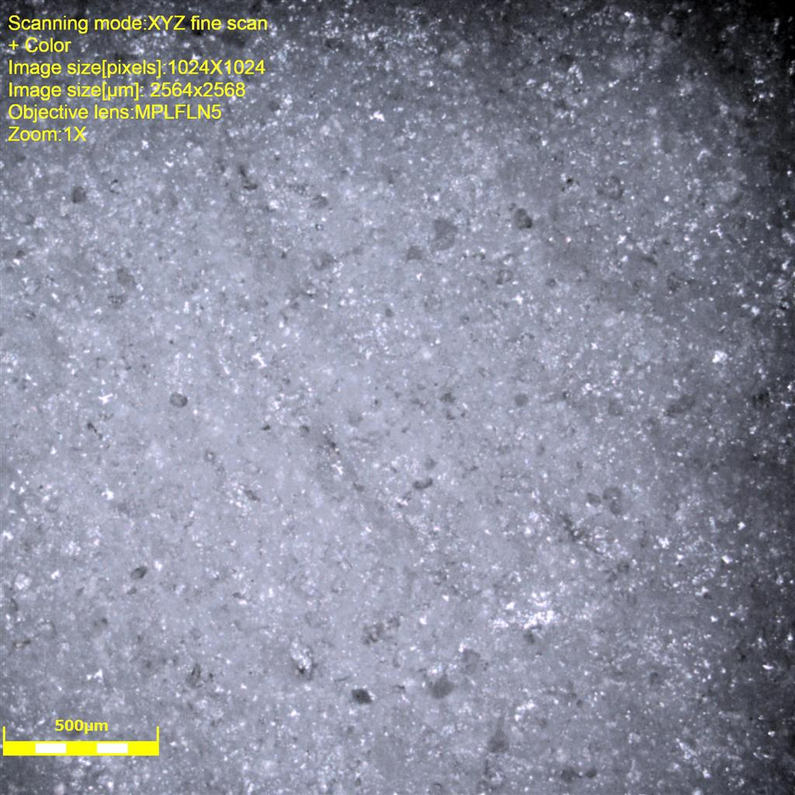
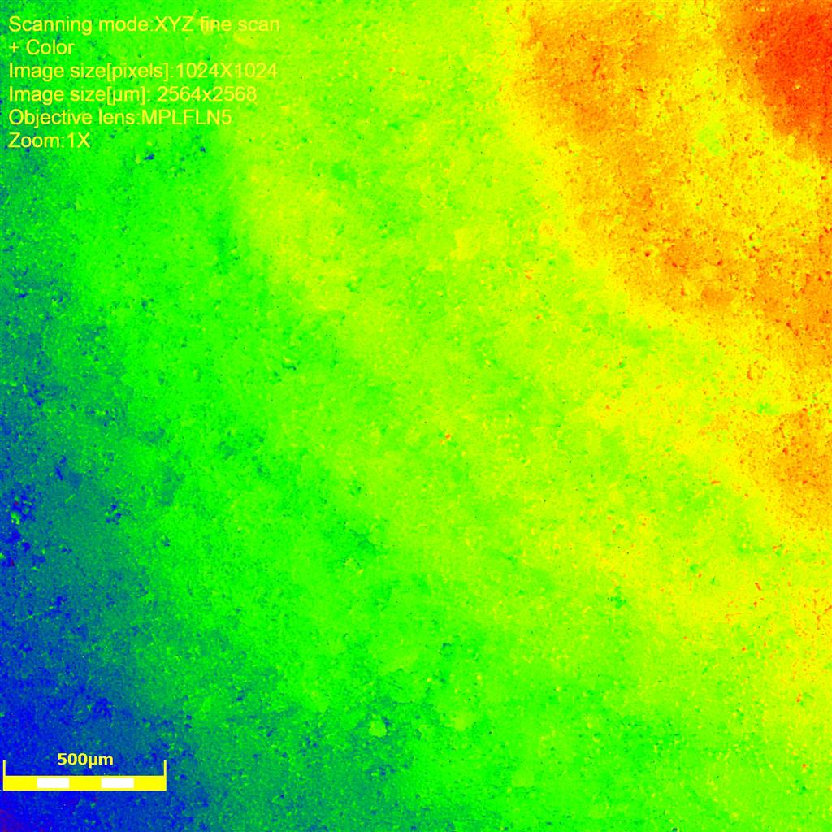
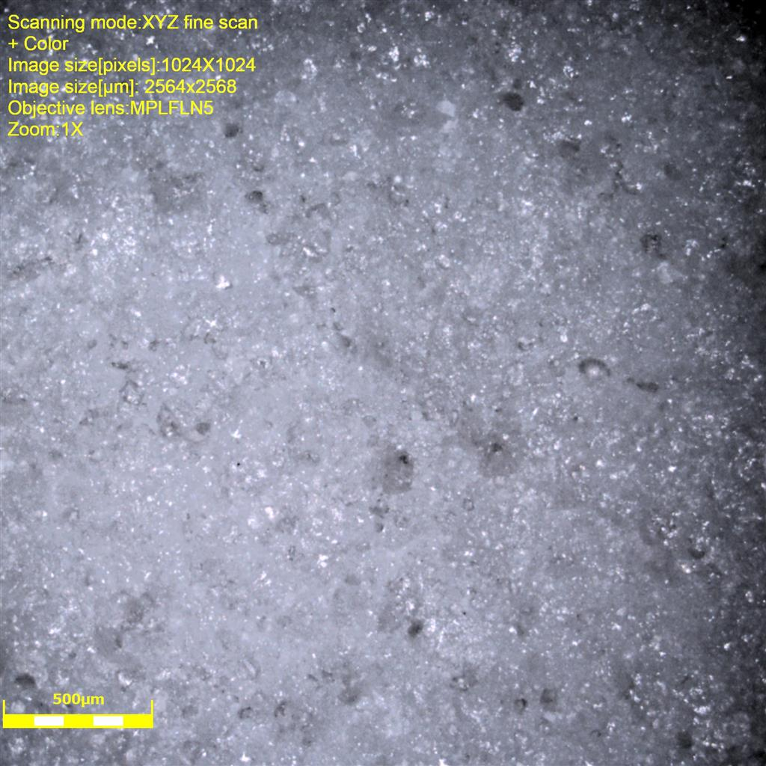
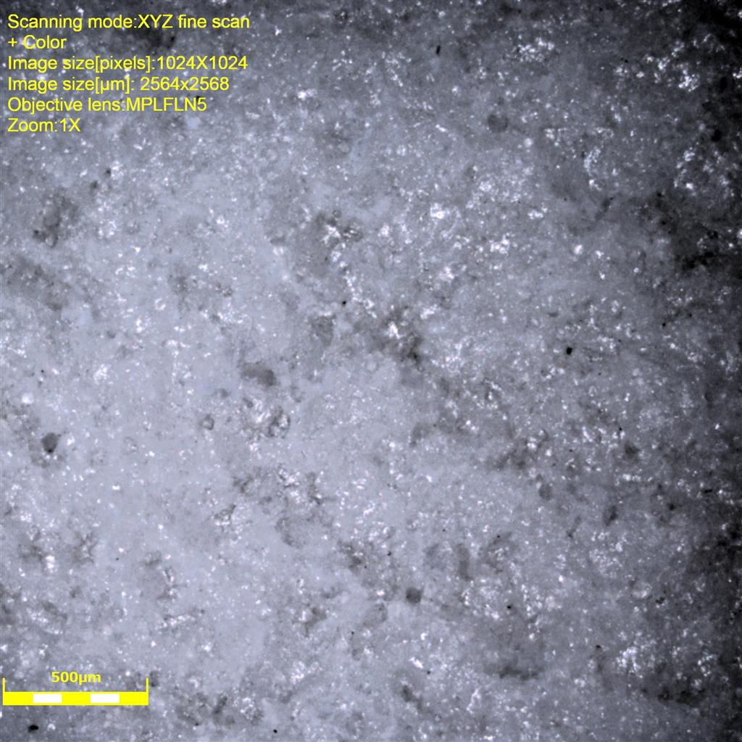
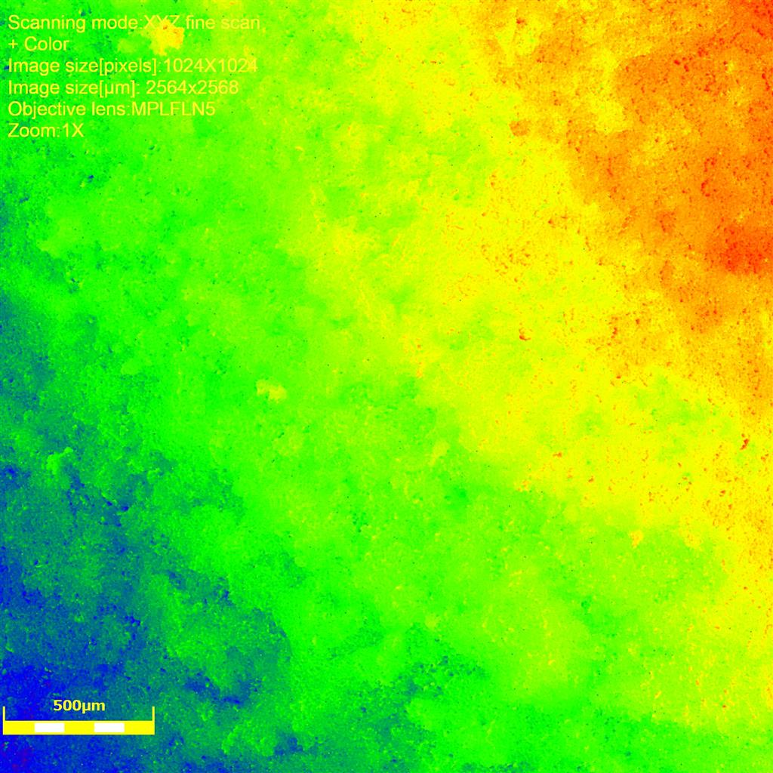
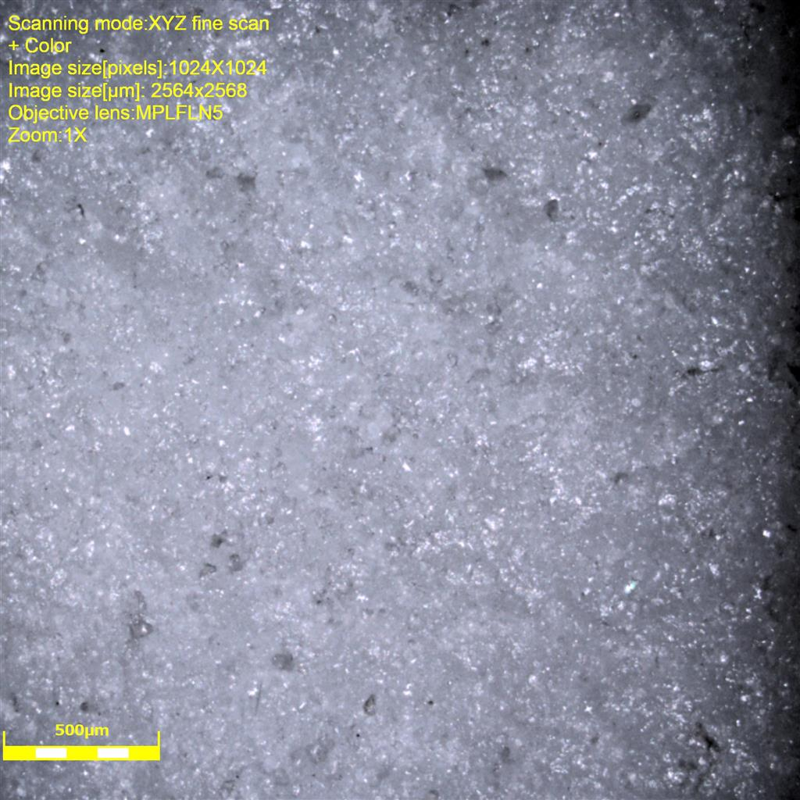
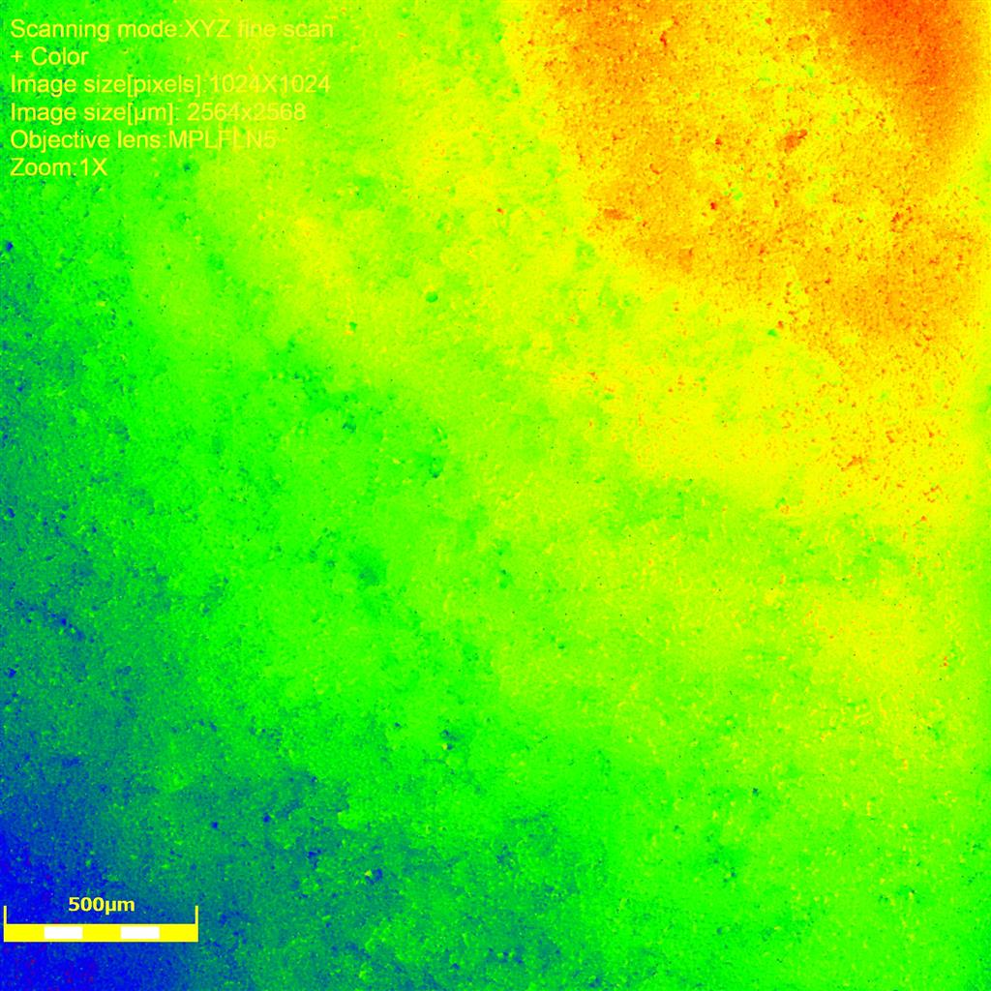
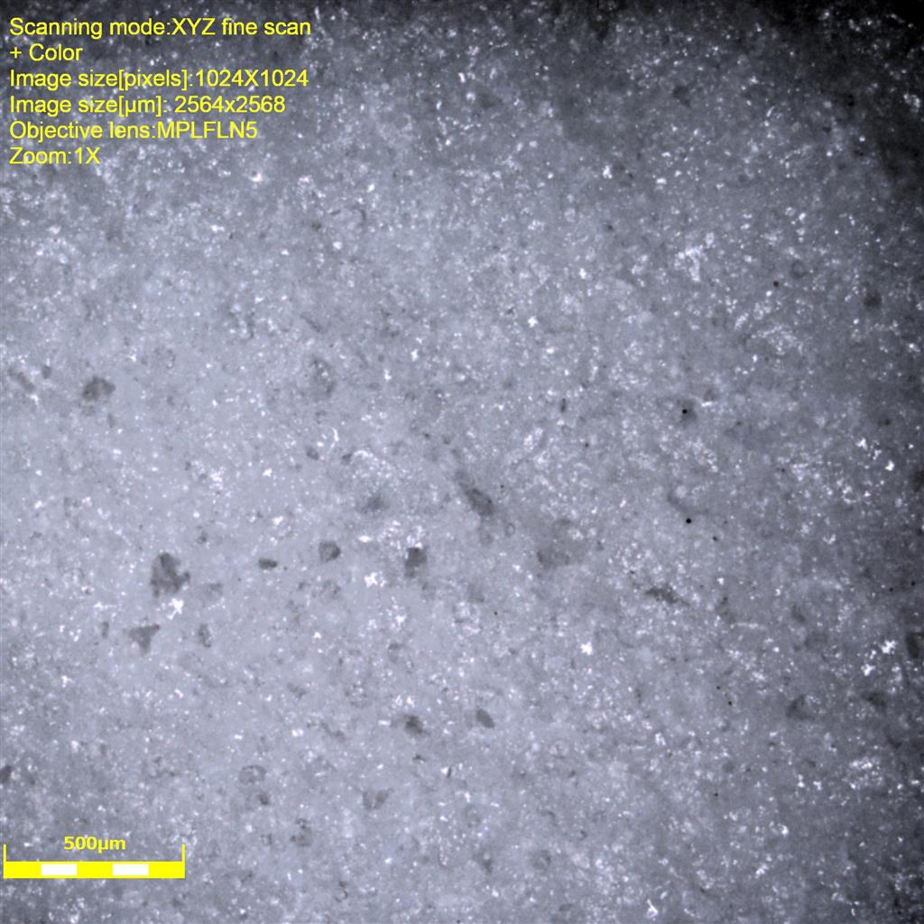
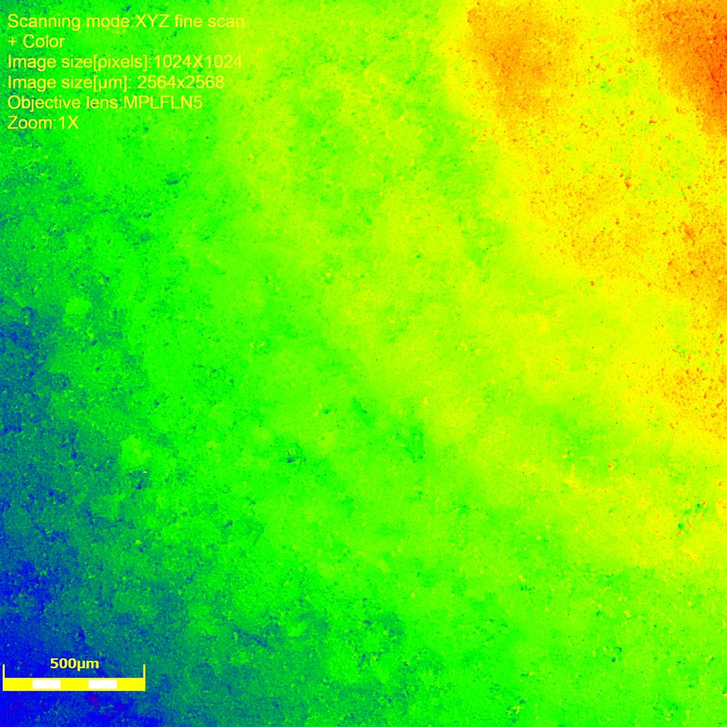
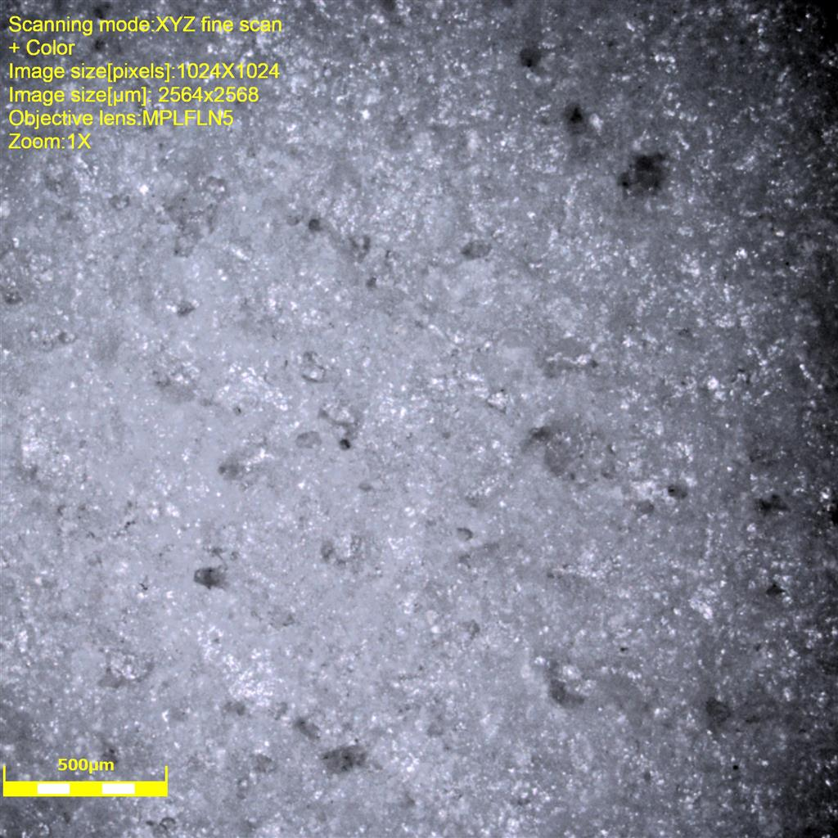
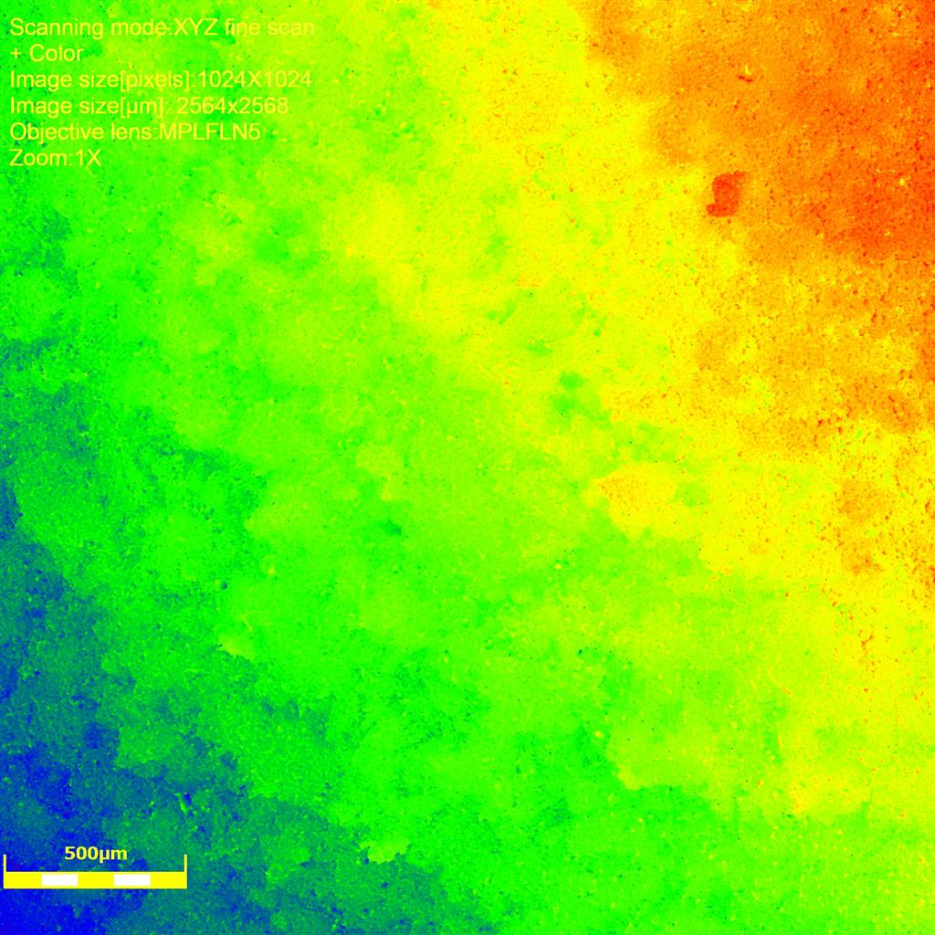
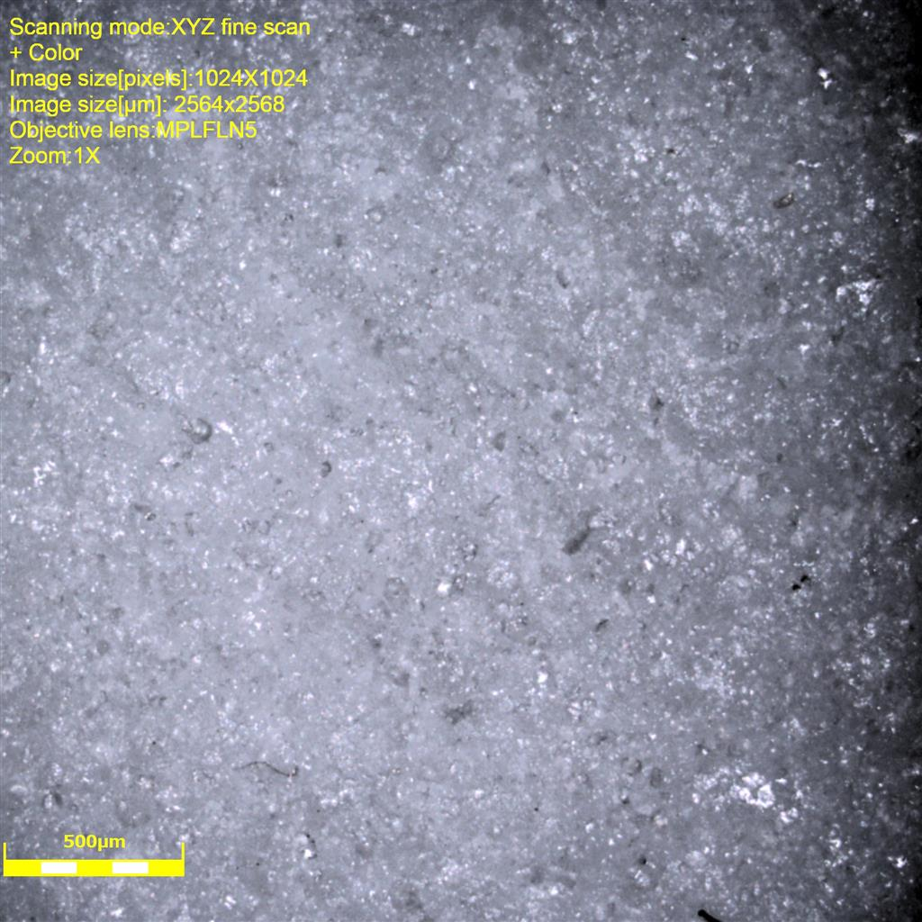
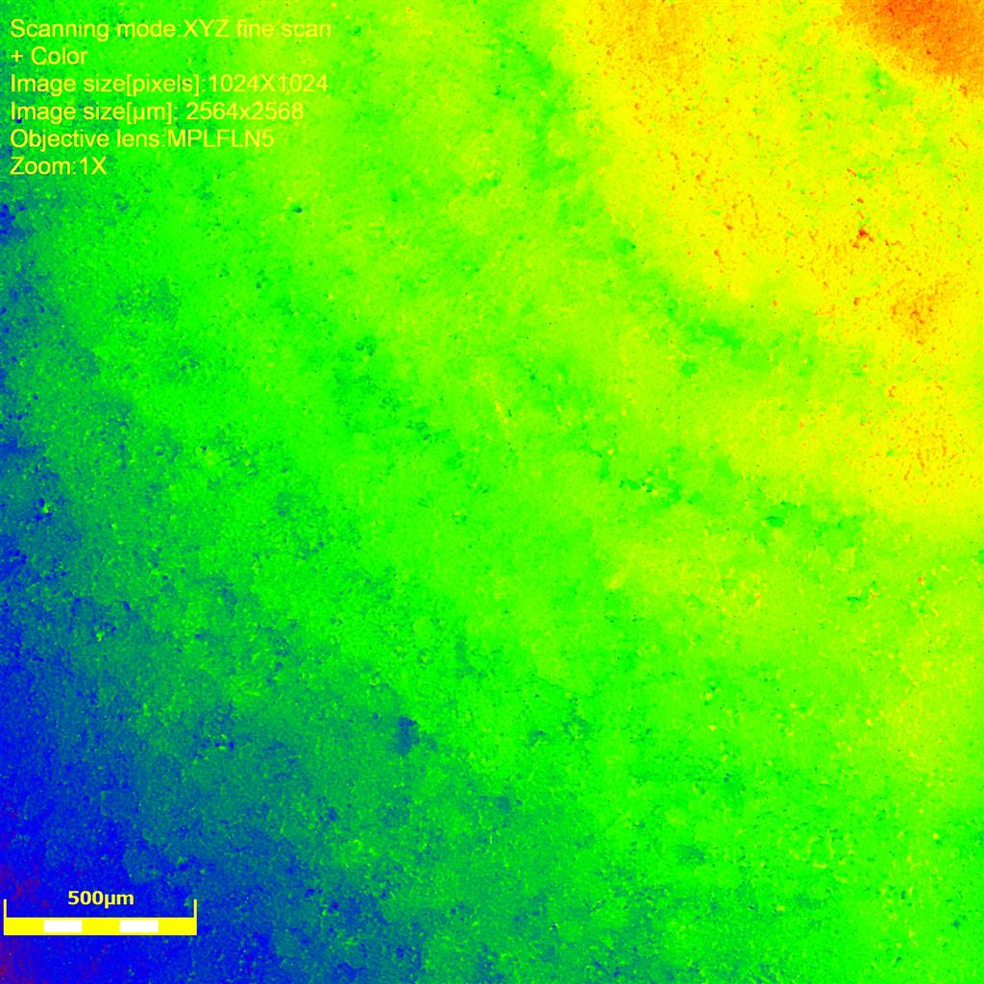
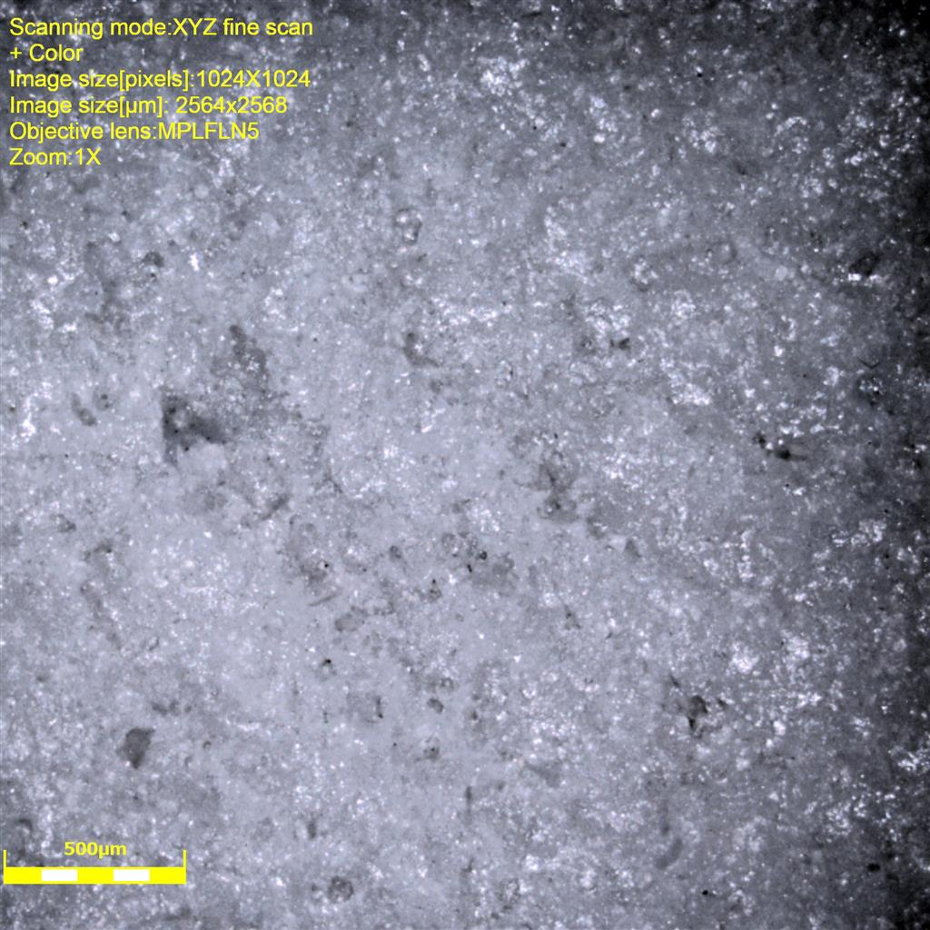
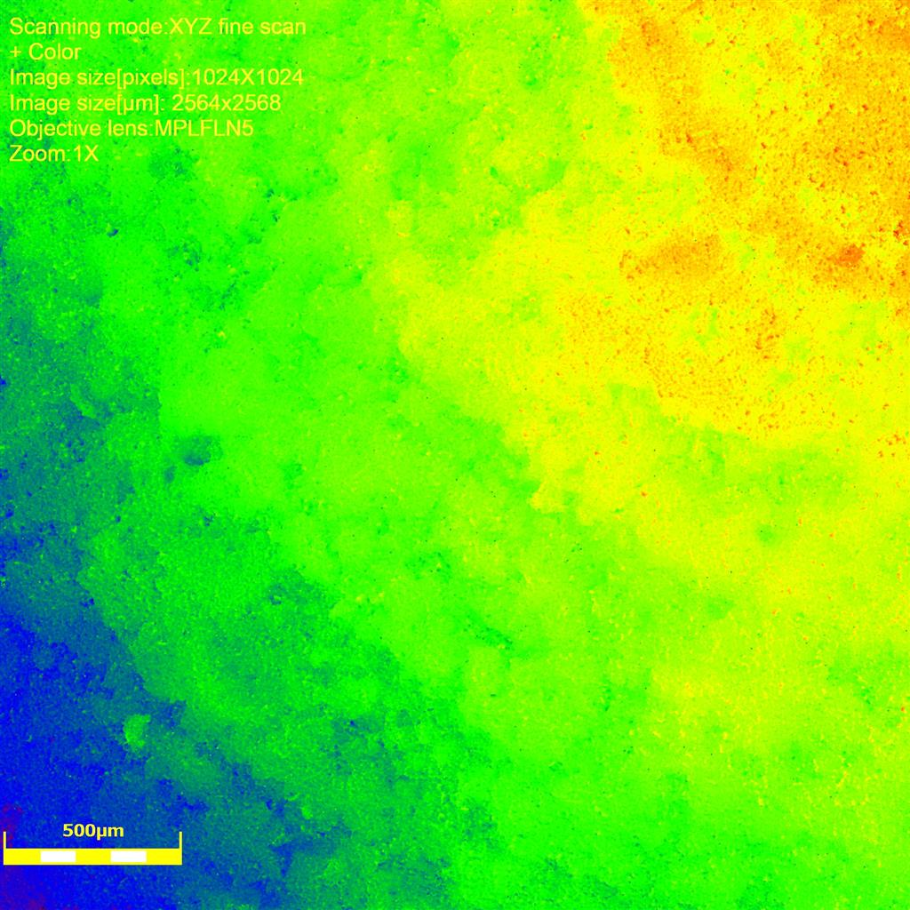
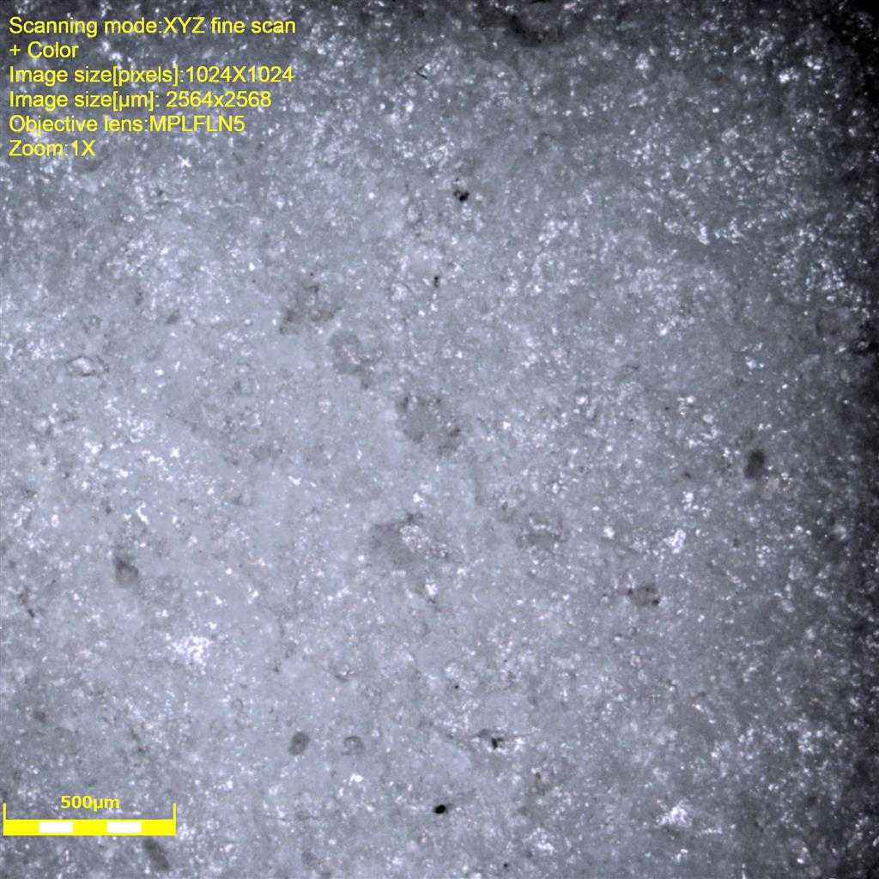
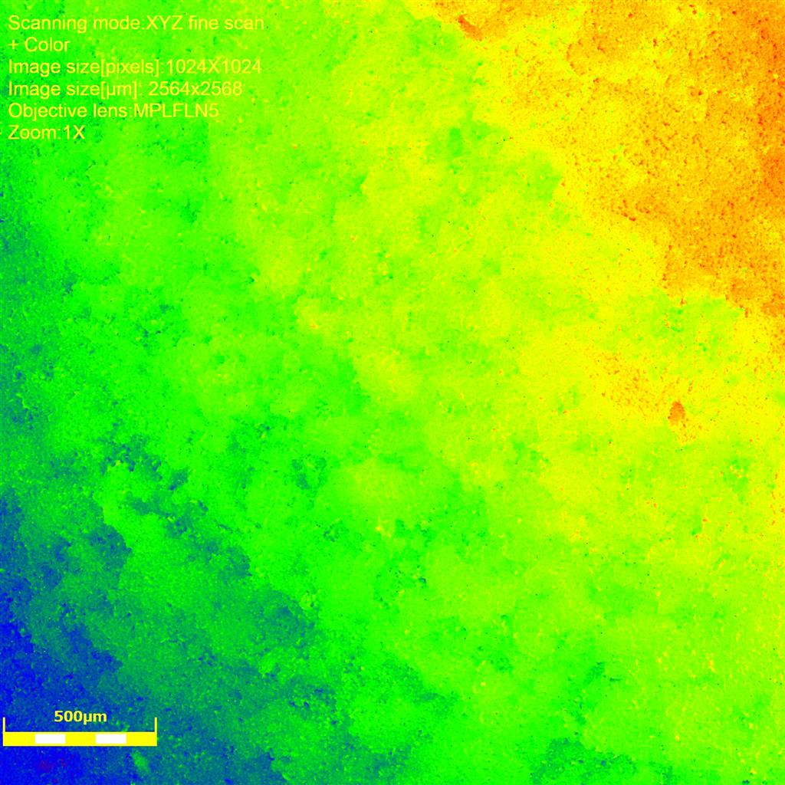
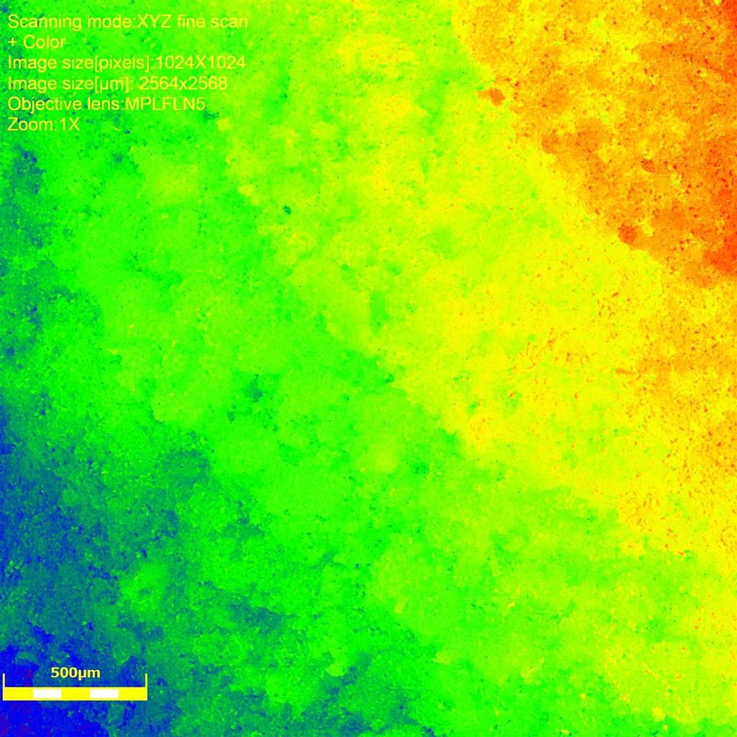
Topx5
3UH
4UH
5F
6F
9H
10H
11UF
12H
Rq
Sq
25.07463583 28.02329531 26.70475096 26.49937899 26.69093111 25.00508199 27.60314748 26.1664469
36.50796905 37.8888487 49.93184145 37.35135372 39.06355563 39.29838897 36.27237264 44.98530135
12UF
13H
14UF
15UF
19UH
20UH
21F
22F
9H
Rq
Sq
26.83100281 30.78686829 26.3334142 29.00745472 27.27643076 25.62265796 25.8714303 25.98227524
34.21509704 38.19913376 42.50375854 37.29622274 40.05884986 37.58121791 40.34996152 38.71396656

Slide 3
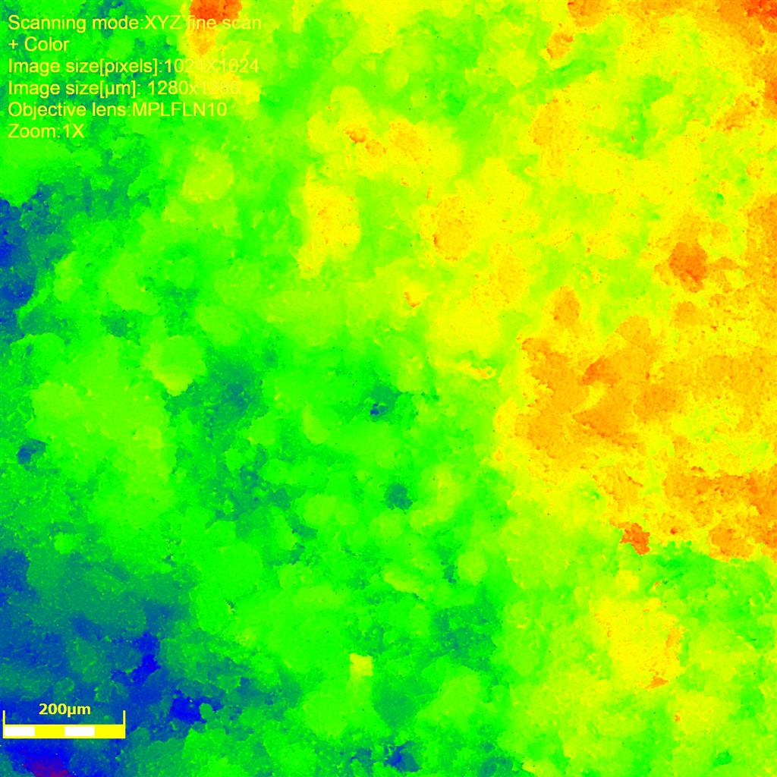
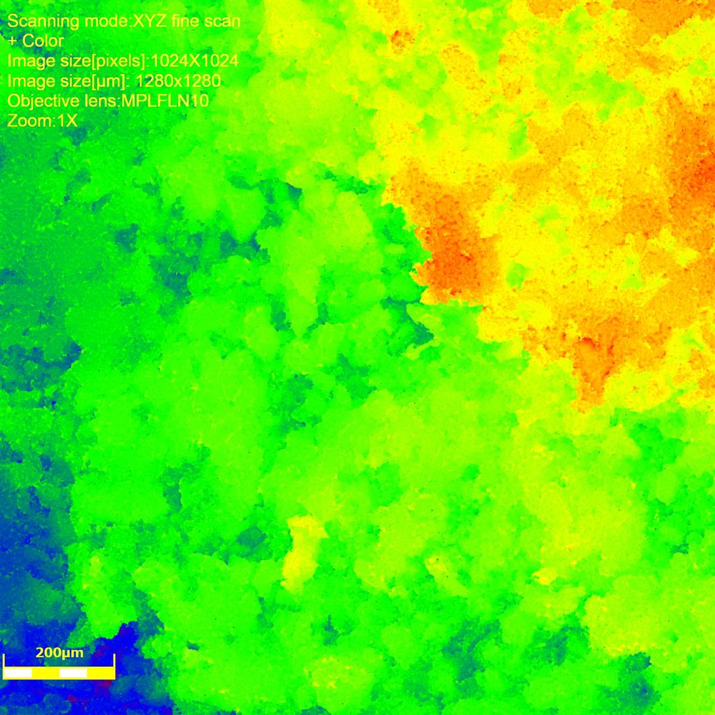
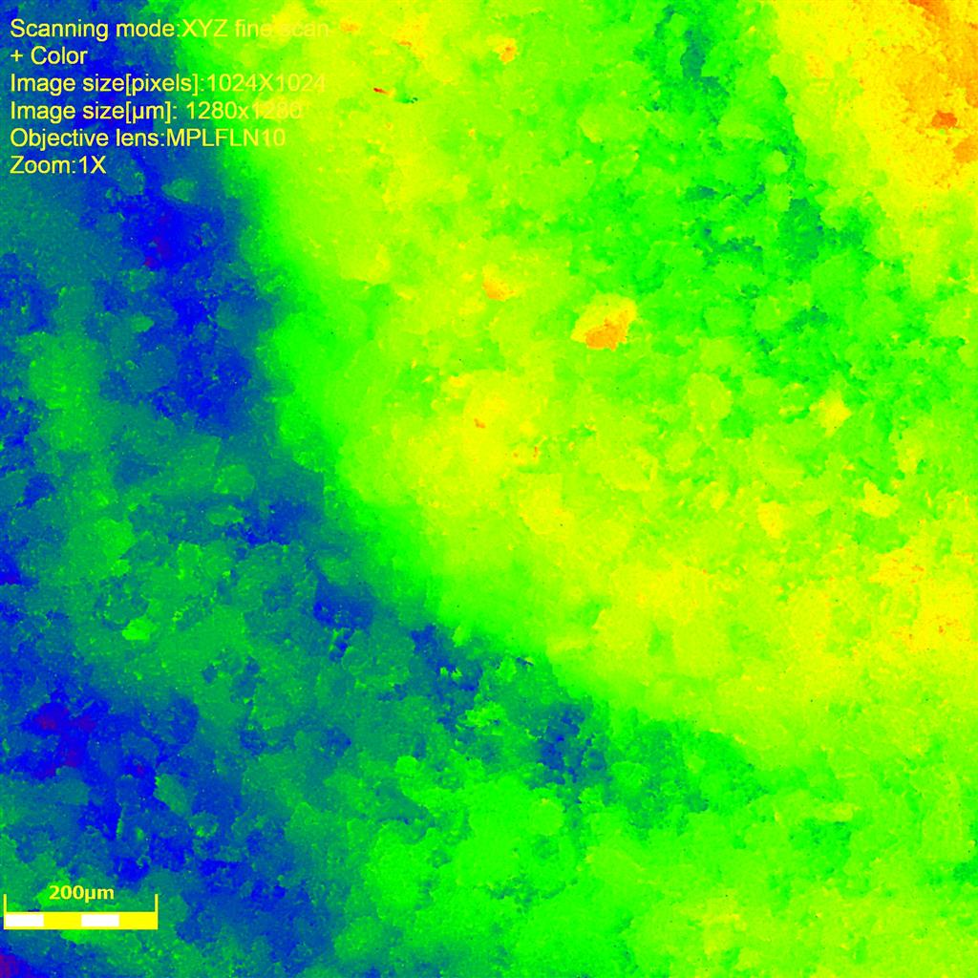
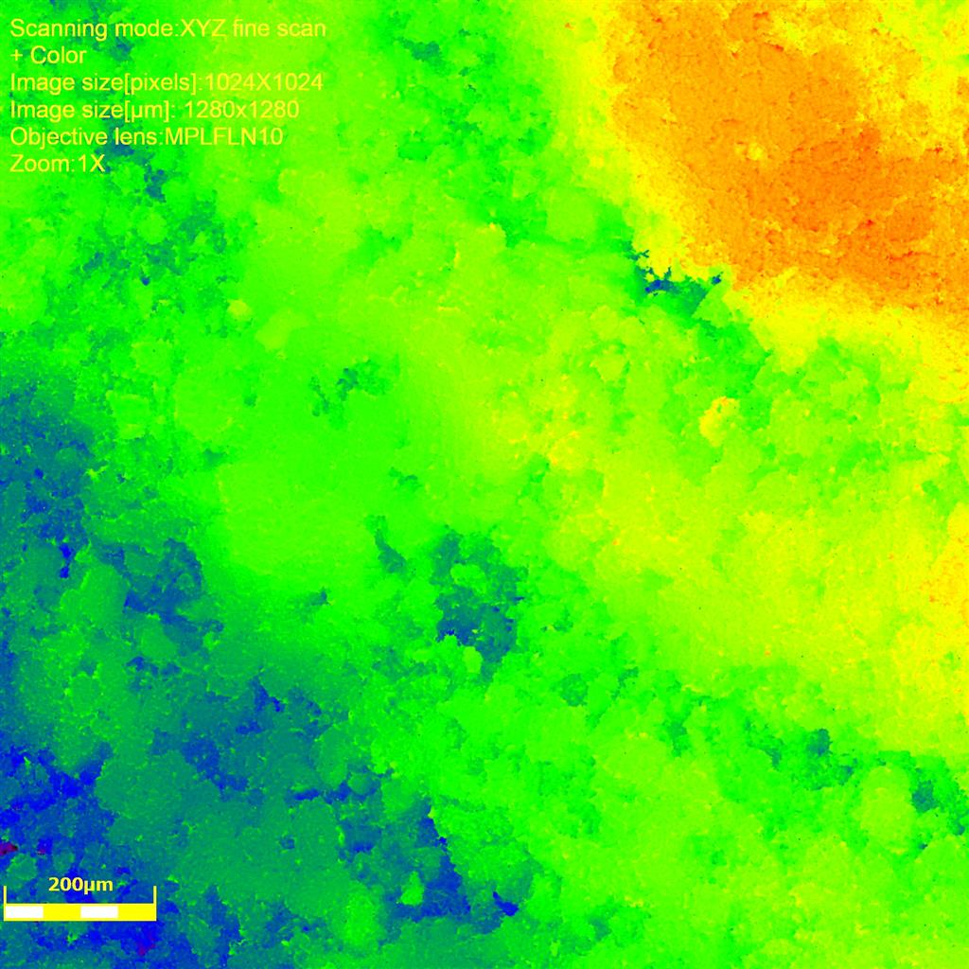
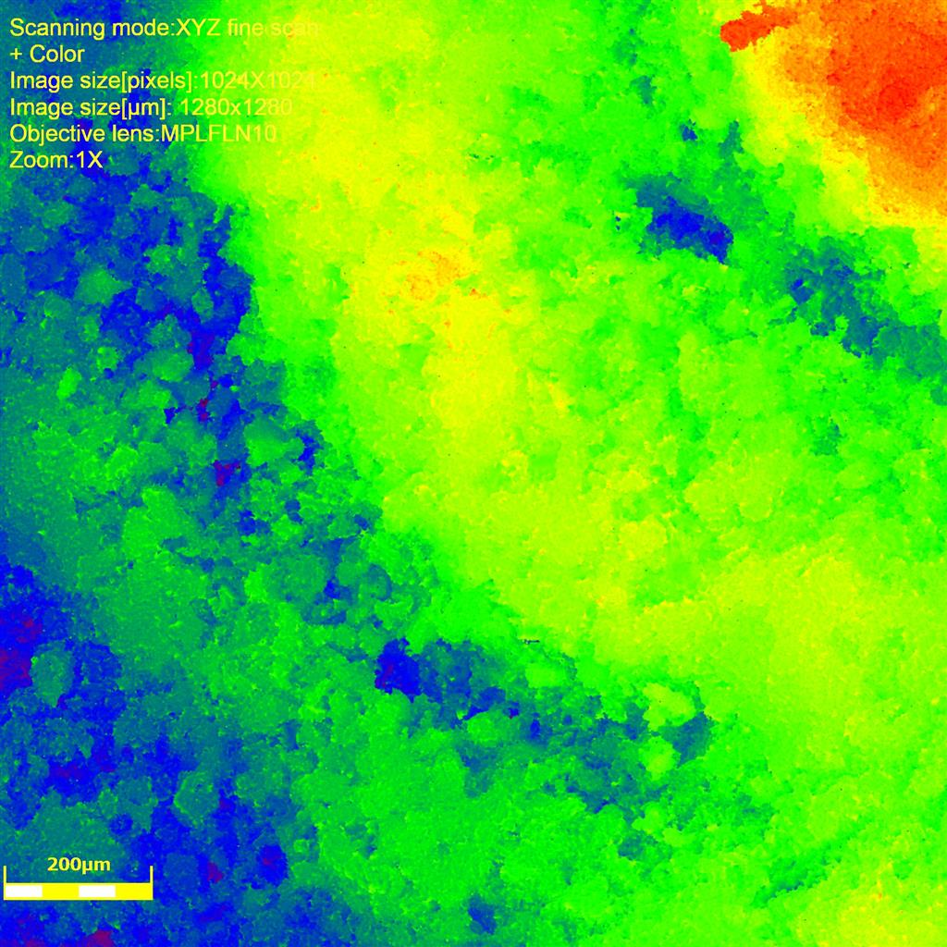
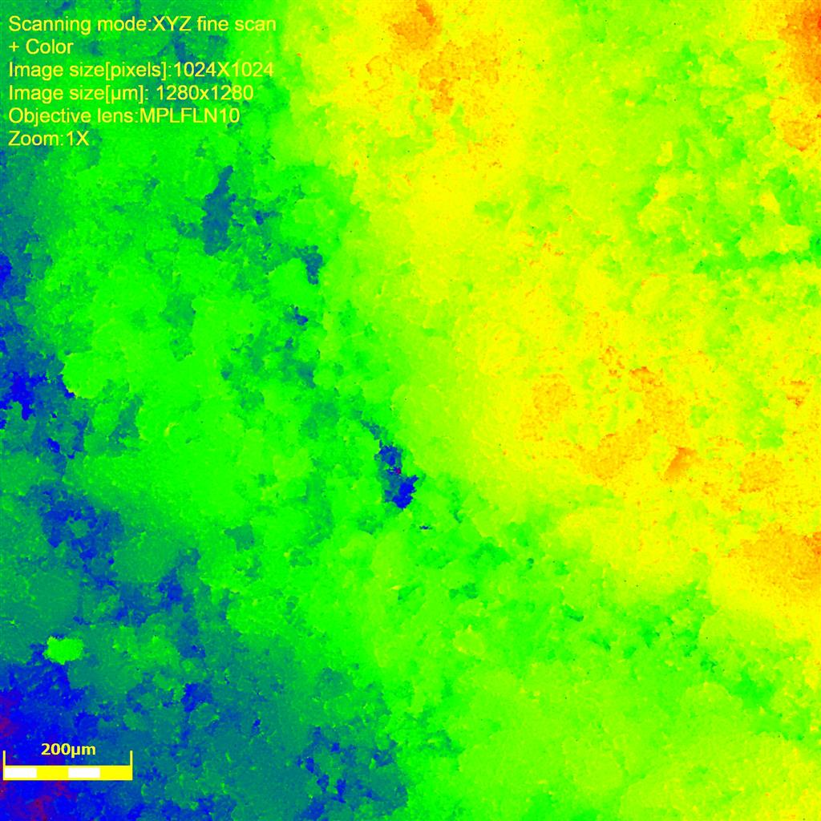
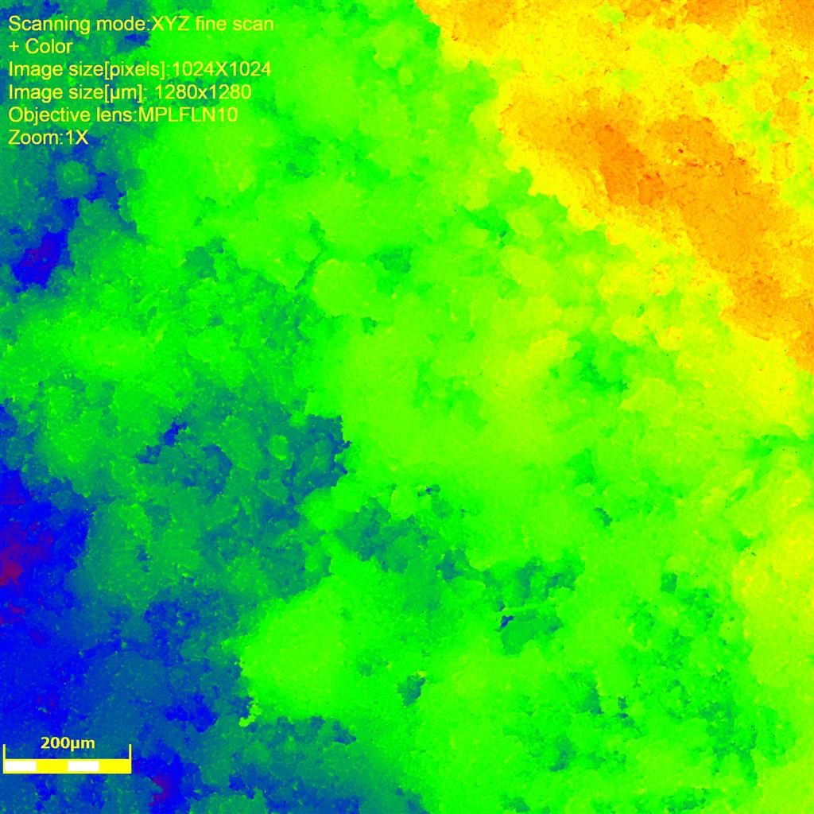
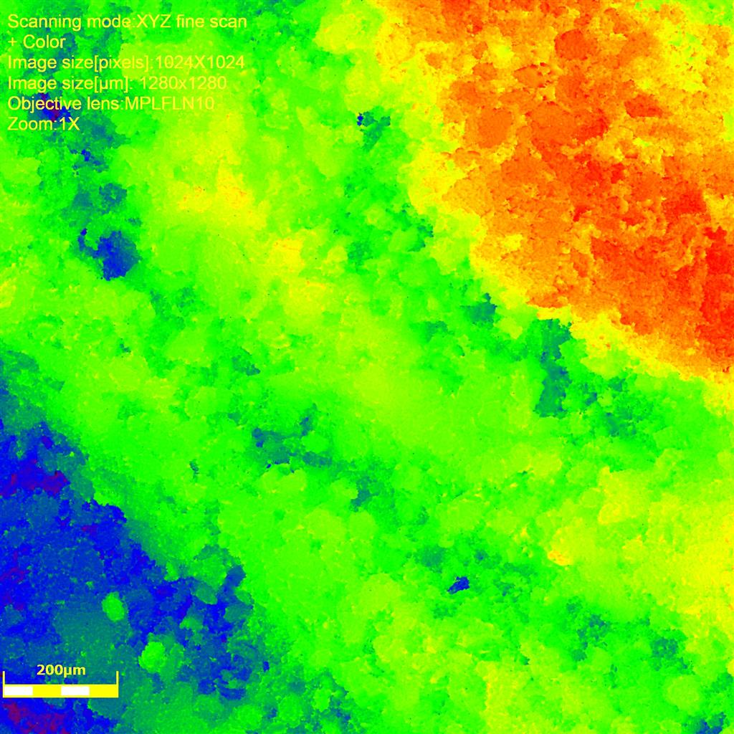
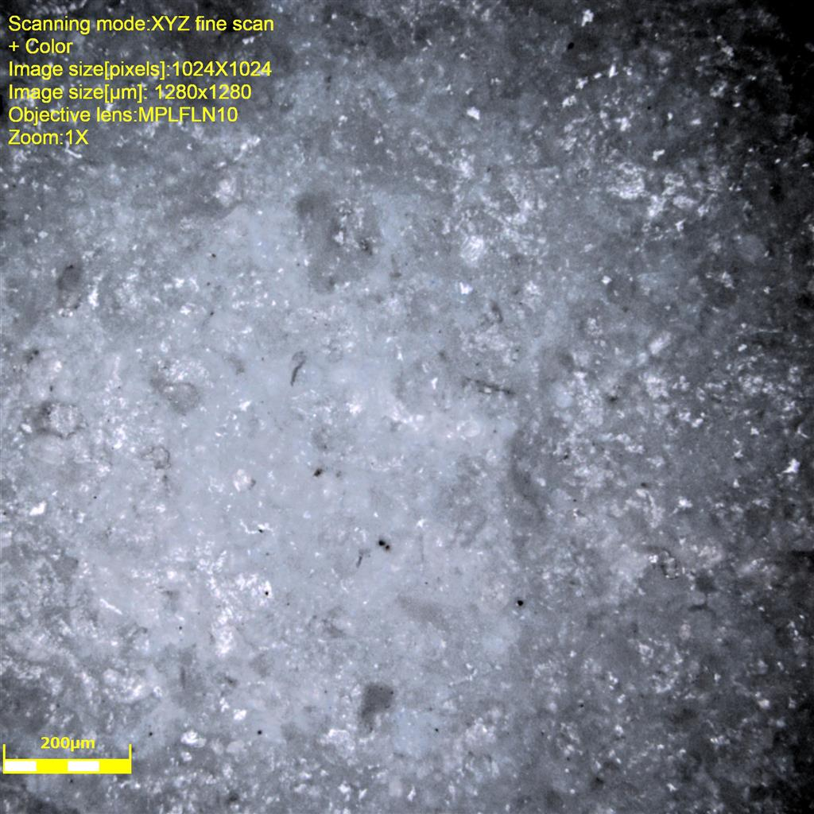
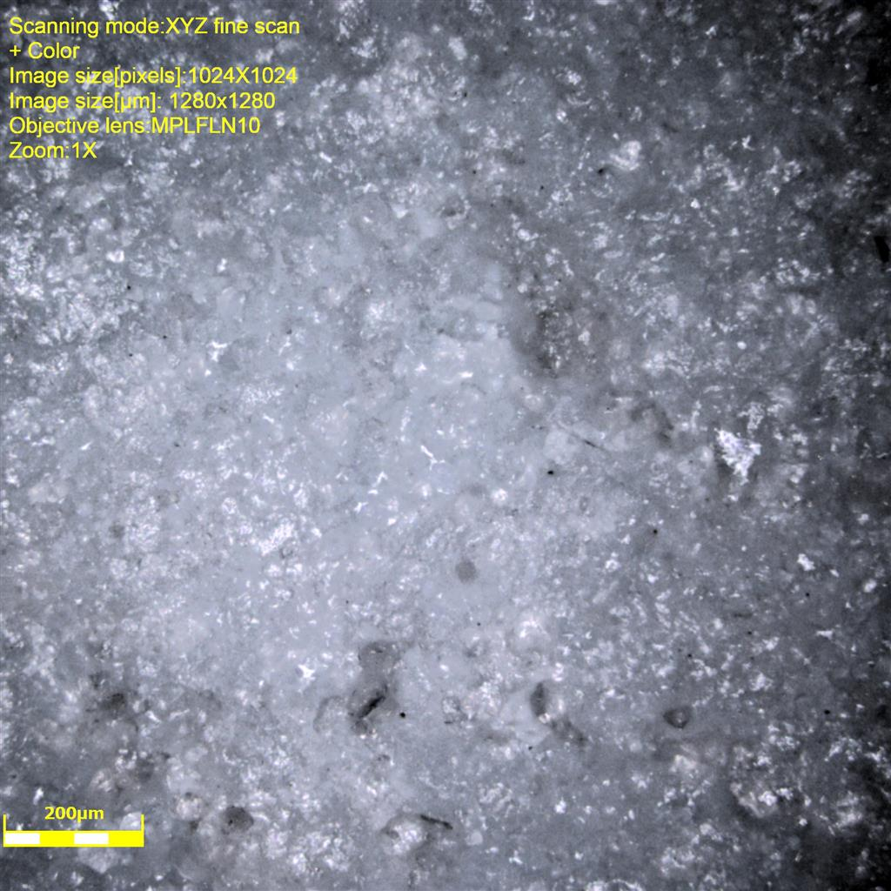
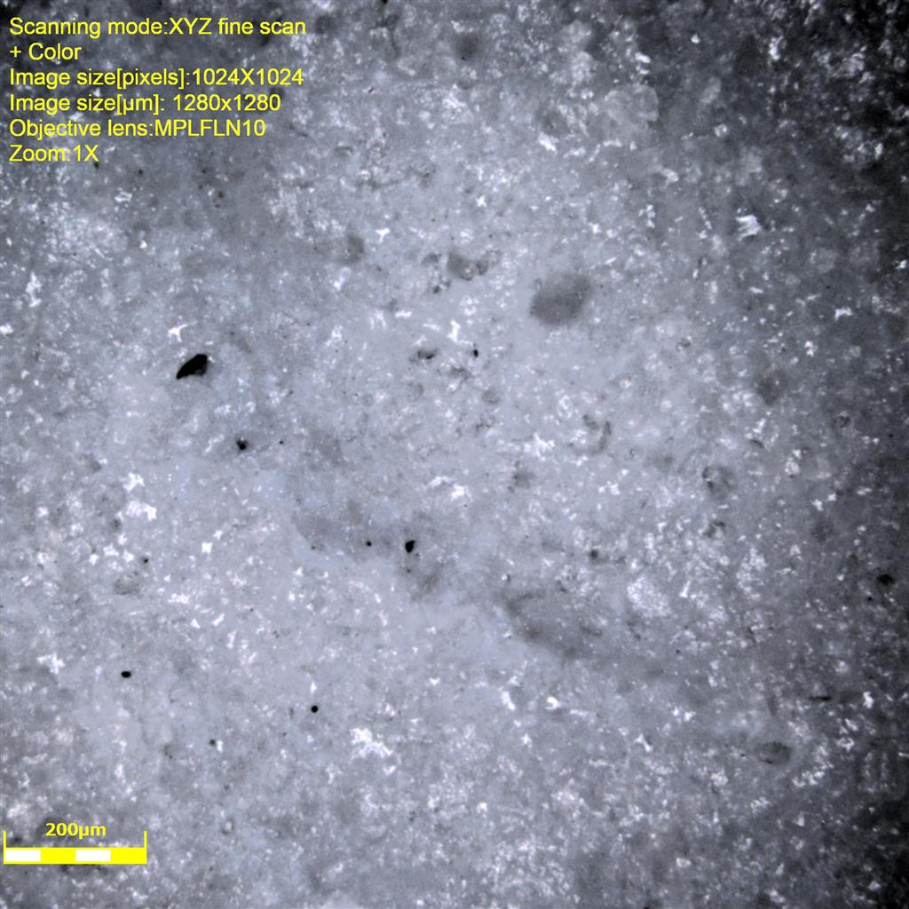
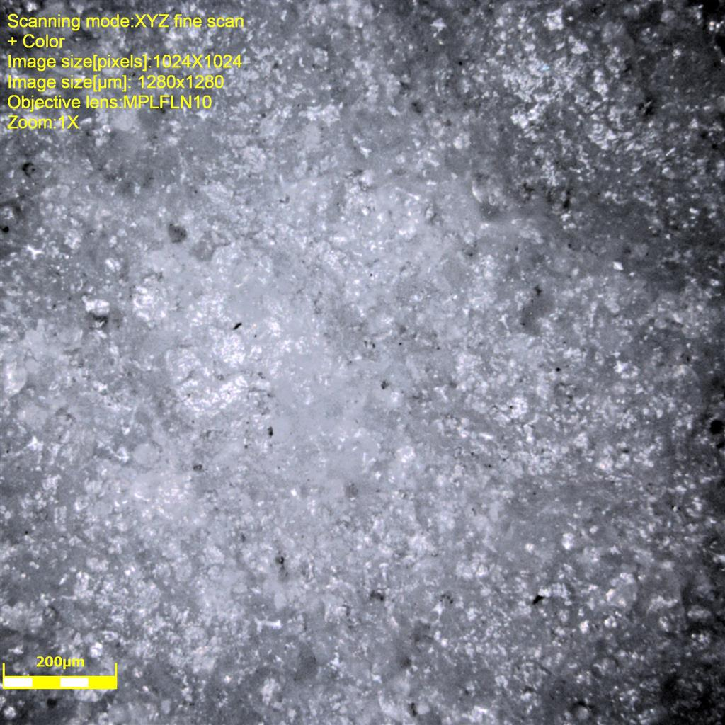
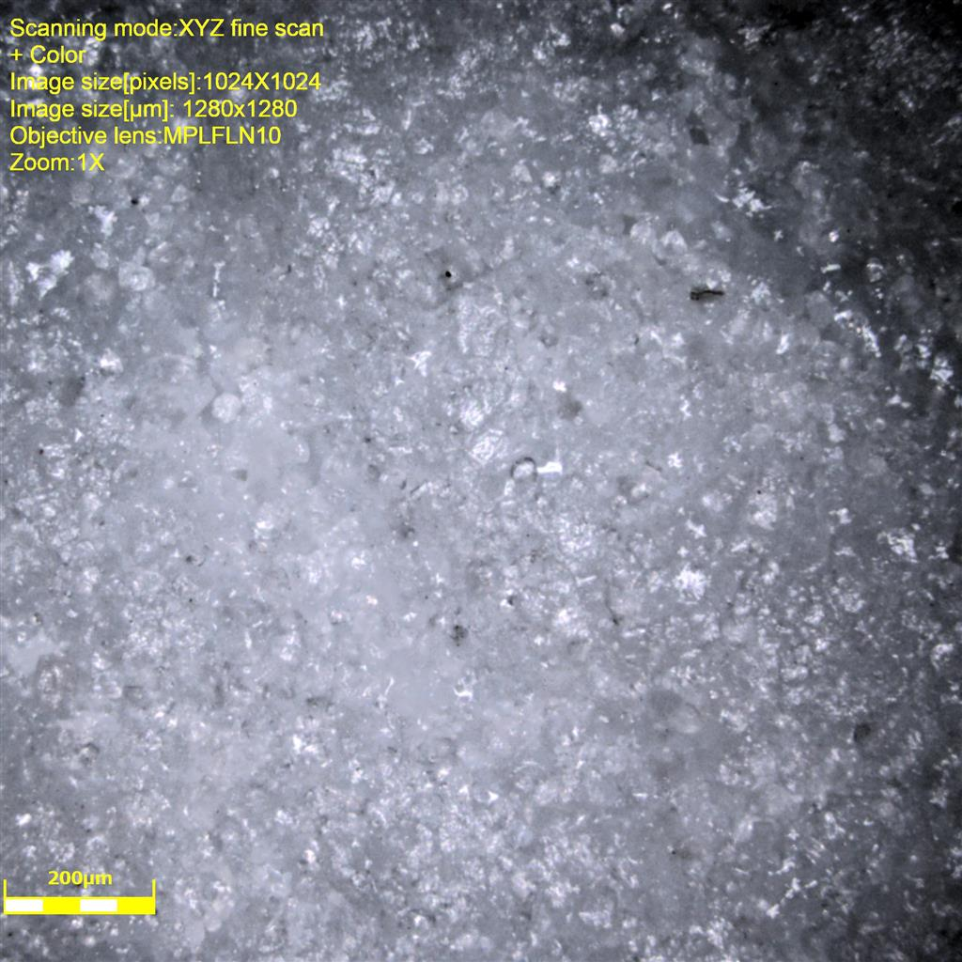
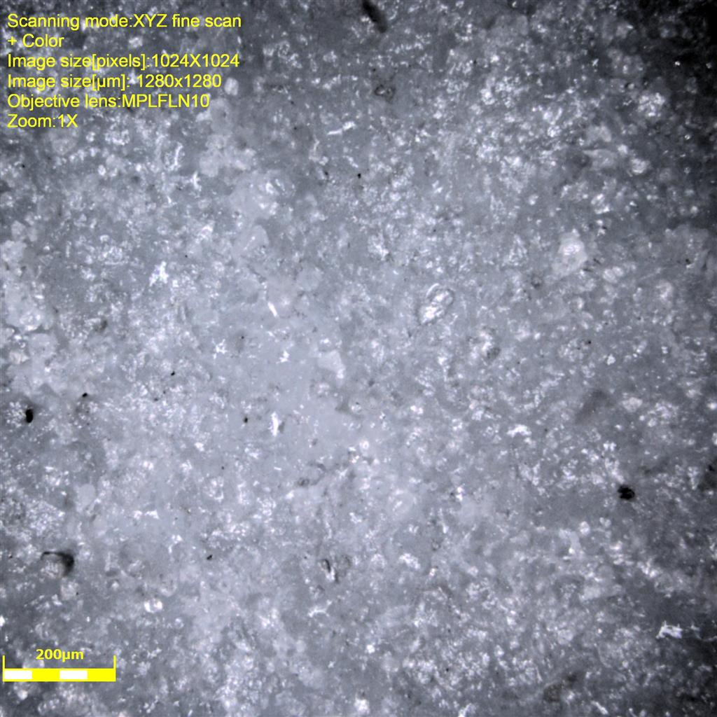
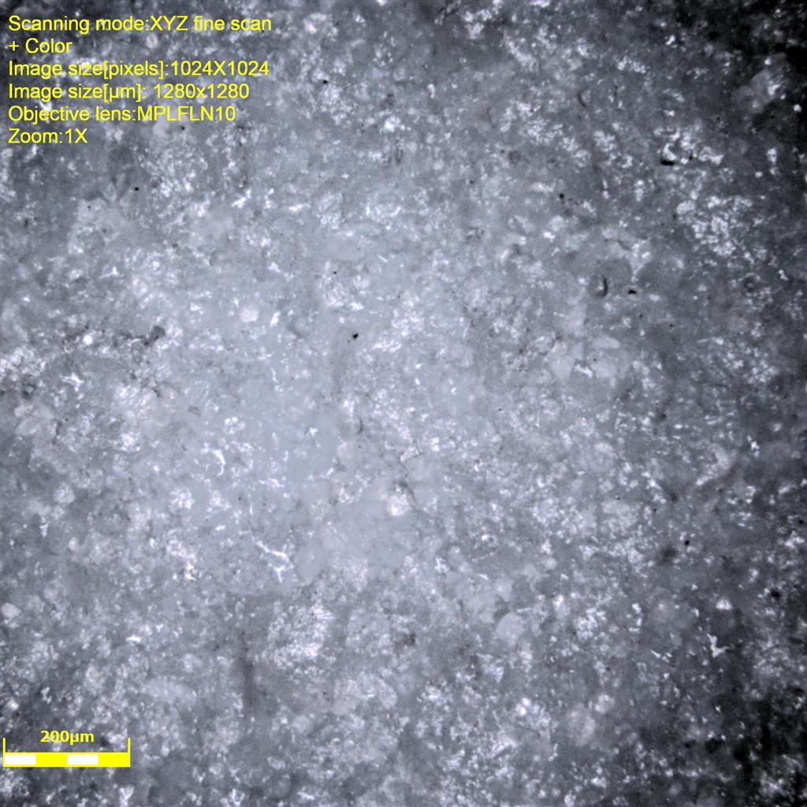



















Topx10
3UH
4UH
5F
6F
9H
10H
11UF
12H
D10
D50
D90
9.029 8.573 8.691 8.461 8.921 8.576 8.577 8.806
13.669 13.0775 13.1555 12.9255 13.3075 13.155 13.153 13.456
20.819 19.9935 19.697 19.592 20.1925 19.795 20.437 20.2895
12UF
13H
14UF
15UF
19UH
20UH
21F
22F
D10
D50
D90
8.3445 8.694 8.5765 8.461 8.921 8.9215 8.577 8.576
12.768 13.23 13.228 13.001 13.89 13.67 13.153 13.077
19.338 20.244 20.194 19.898 21.2025 20.916 20.0445 19.898

Slide 4


































Topx20
3UH
4UH
5F
6F
9H
10H
11UF
12H
Rq
Sq
D50
15.062564 21.29048572 19.0351136 28.18981379 29.90770422 17.3307568 18.52136005 27.25119481
20.14221259 27.25720696 29.58111312 30.75087131 31.37320888 21.66914261 23.80413728 31.282903
5.545 5.547 5.632 5.451 5.681 5.681 5.406 5.633
12UF
13H
14UF
15UF
19UH
20UH
21F
22F
Rq
Sq
D50
9.704427313 23.75465863 12.20609848 17.79592742 19.94976807 14.31628624 16.07847132 16.58880391
12.49753688 25.16333069 21.8195133 18.76128779 25.41935339 18.89558083 20.20033158 22.34914618
5.1705 5.636 5.4525 5.314 5.59 5.4975 5.6815 5.633

Slide 5
















































Bottomx5
3UH
4UH
5F
6F
9H
10H
11UF
12H
26.91513 28.92252 19.07043 24.32174532 31.08213788 18.68976 26.74265 28.6991
Rq
Rq
21.13485 27.64937 24.66684 24.74385 28.93617 26.13184 25.19344 23.02473
12UF
13H
14UF
15UF
19UH
20UH
21F
22F

Slide 6
















































Bottomx20
3UH
4UH
5F
6F
9H
10H
11UF
12H
Span
1.048300537 1.046880635 1.01767358 1.014554954 1.005638414 1.033192738 1.006549027 1.015726179
Span
1.029834455 1.011276828 1.016921397 1.026741859 1.036019647 1.068023469 0.999823975 1.010915819
12UF
13H
14UF
15UF
19UH
20UH
21F
22F

